Slide 1
Pathrise Project
Data Roadmap final Assignment
Reza Saeedisepehr

Slide 2
Introduction to Pathrise company
Pathrise Project
Outlines
Methodology
Data Collection
Data Wrangling
Exploratory data analysis(EDA)
Performing Machine learning

Slide 3


Pathrise Project
Introduction to
Pathrise company
MANIFESTO: We seek to uplift job seekers in their careers and help them fulfill their hopes, ambitions and livelihoods.

Slide 4
Pathrise Project
Pathrise's company as a recruitment agency holds a program which helps job seekers find a job. Actually this project is a combination of a classic classification problem and regression According to data of people getting involved in Pathrise's program in the past, the project has two main Objectives.
Preparing a model to predict whether people would find a job or not ?
Preparing a model to predict how long does it take to find a job?

Slide 5
Methodology
Executive Summary
Data collection methodology:
Data is provided by Pathrise company in excel format.
Perform data wrangling
Converting categorical data
Dealing with missing values
Working with outliers
Perform exploratory data analysis (EDA) using visualization
Perform predictive analysis using classification and regression models
Four models are trained and examined by grid search method with different hyper-parameters and eventually the best model with the lowest error is selected to predict whether or not someone would find a job
Three regression models are trained and finally the best model with the lowest error is selected to predict how long how long a person would find a job

Slide 6
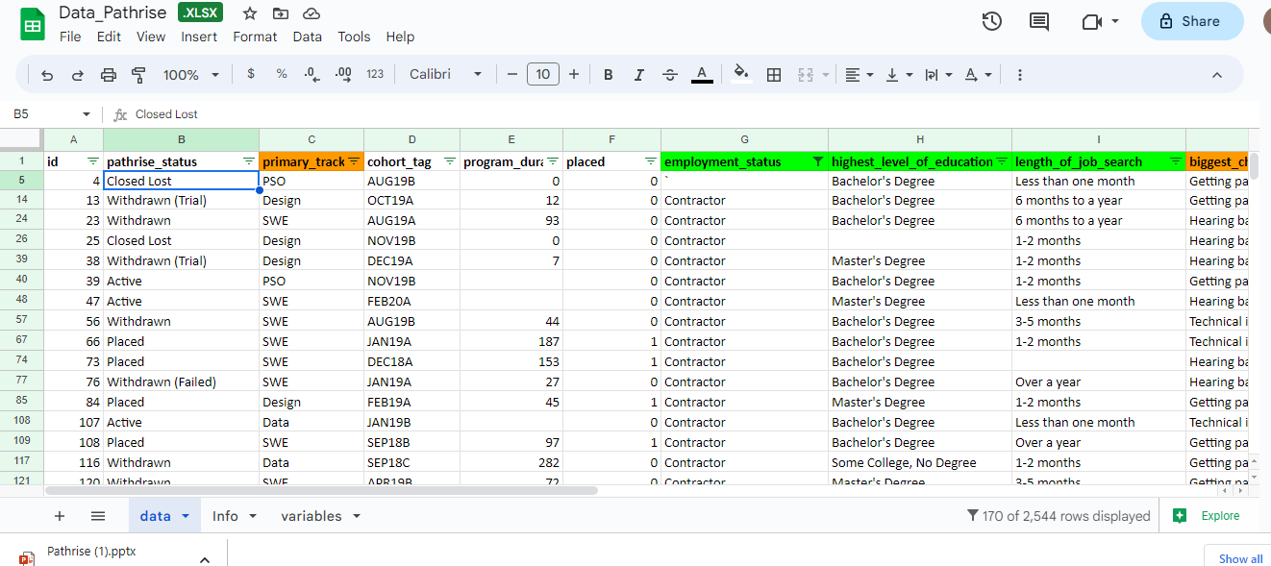
Data Collection
Tabular data is provided by Pathrise company in excel format
Items | values
Number of column | 16
Number of rows | 2544
percentage of Numerical columns | 31.25%
percentage of Categorical columns | 68.75%
Average percentage of missing values | 5.46%

Slide 7
Data Wrangling
And
Main Challenges
Taking an appropriate approach to deal with Categorical data
More than 68% of data is categorical
Choosing suitable methods to solve the missing values issues
Some columns includes more than 24% missing values.

Slide 8
Data preparation approach
Action plan to deal with different columns
Column Name | Type | Approaches | Percentage of Missing values | Method to deal with missing values
id | Numerical | Remove/Useless | 0.00% | -
pathrise_status | Categorical/Nominal | Remove/Data leakage | 0.00% | -
primary_track | Categorical/Nominal | Covert to dummy values | 0.00% | -
cohort_tag | Categorical/Ordinal | Convert to start date\Remove | 0.31% | -
program_duration_days | Numerical | - | 24.21% | calculation based on cohort _tag
placed | Numerical | - | 0.00% | -
employment_status | Categorical/Ordinal | Replaced by ordinal number/Remove | 9.00% | Calculation based on high frequency
highest_level_of_education | Categorical/Ordinal | Replaced by number of year spent on education/Remove | 2.28% | Calculation based on high frequency
length_of_job_search | Categorical/Ordinal | Replaced by average value of period/Remove | 2.91% | Calculation based on Average
biggest_challenge_in_search | Categorical/Nominal | Covert to dummy values | 0.94% | Replaced by No challenge
professional_experience | Categorical/Ordinal | Replaced by average value of period/Remove | 8.73% | Calculation based on Average
work_authorization_status | Categorical/Nominal | Covert to dummy values | 10.14% | Calculation based on high frequency
number_of_interviews | Numerical | - | 8.57% | Calculation based on Average
number_of_applications | Numerical | - | 0.00% | -
gender | Categorical/Nominal | Covert to dummy values | 19.97% | Calculation based on high frequency
race | Categorical/Nominal | Covert to dummy values | 0.71% | Calculation based on high frequency

Slide 9
Data preparation approach
Remove people who did not get involved in Pathrise program
Pathrise status | status of a fellow in the program
Break | on a temporary break
Closed Lost | didn't accept our offer
Deferred | accepted our offer, but willing to start later
MIA | missed in action - joined the program, but stopped being involved
Pathrise Program
According to variable definition for pathrise_status these people did not participate in Pathrise Program actually

Slide 10
Finding start program date
1. Cohort tag: each cohort starts on the first (A) and the third week (B) of the month. For instance, FEB20A/FEB20B cohort starts on the first/third Monday of February 2020.
2. Define a “get_mondy” function to convert Cohort tag data to date format
Current date
assumption
1. Program duration day: show many days a fellow was in the program, N/A for current fellows
2. The most recent date according to the cohort tag column is assumed as the current date
Calculating Program duration for current student
Difference between start program date and current date is considered as program duration days for current student
Pathrise project
How to calculate program duration for missing values
Time line
Start date |  |  | Program duration |  |  |  | Current date
S1
S2
S3
S4
S5
S6
*S stands for current student

Slide 11
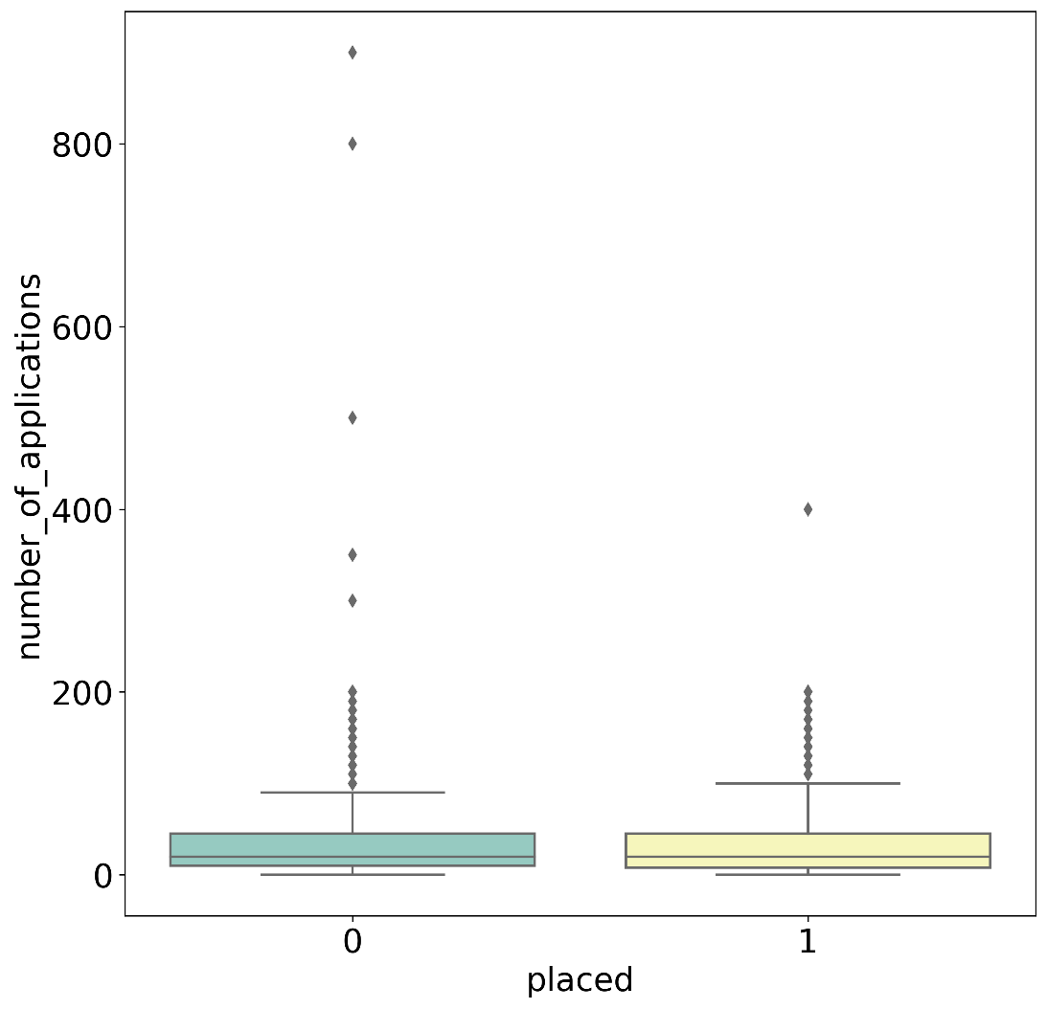
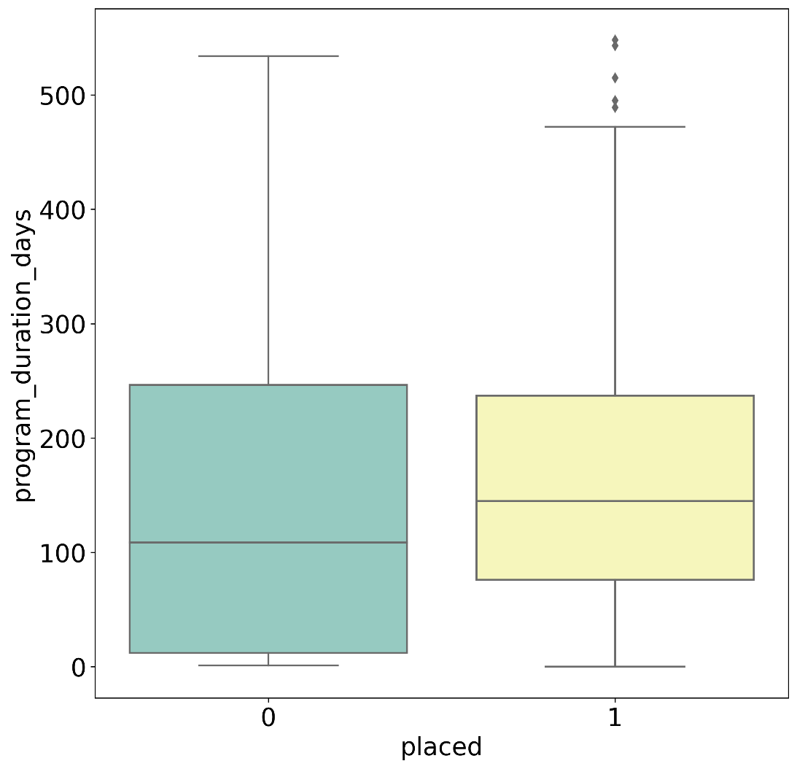
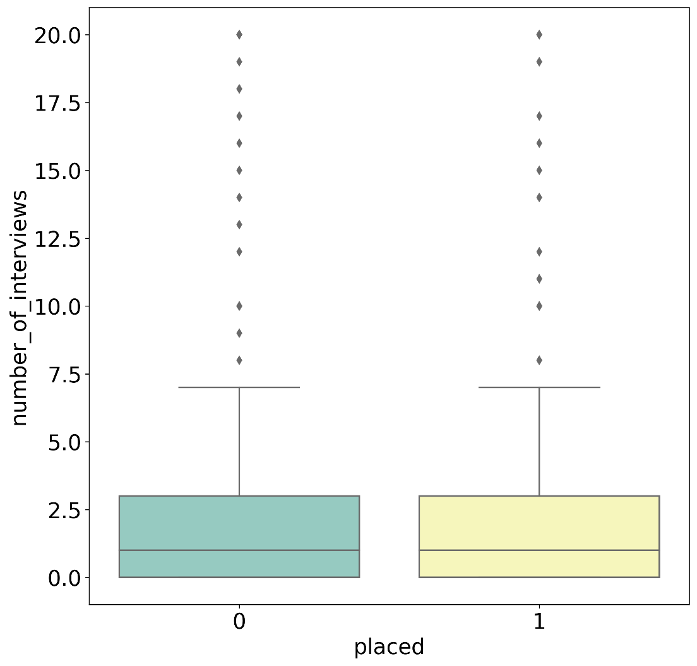
Pathrise project
Working with Outliers
Exploration of data reveals that numerical columns of dataset including “number of applications”, “number of interviews” and “program duration days” have outliers
Interquartile range(IQR) is used to indicate the outlier
Outliers are replaced by mean values.
Outliers
Upper limit Q3+1.5IQR

Slide 12

Exploratory data analysis(EDA)

Slide 13
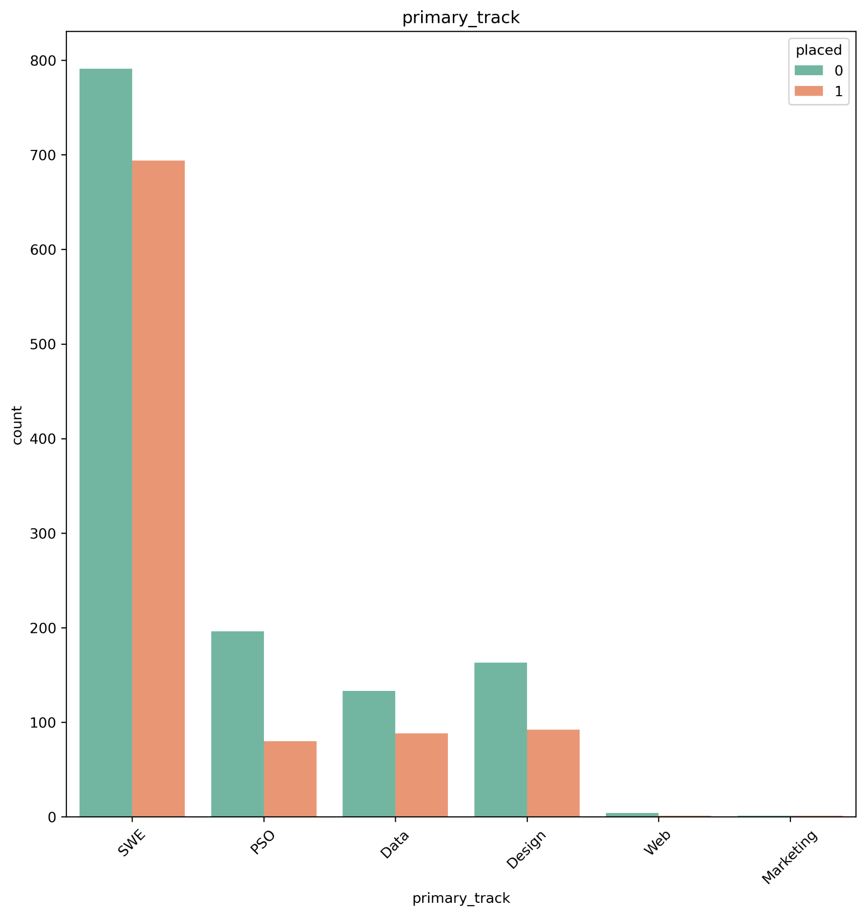
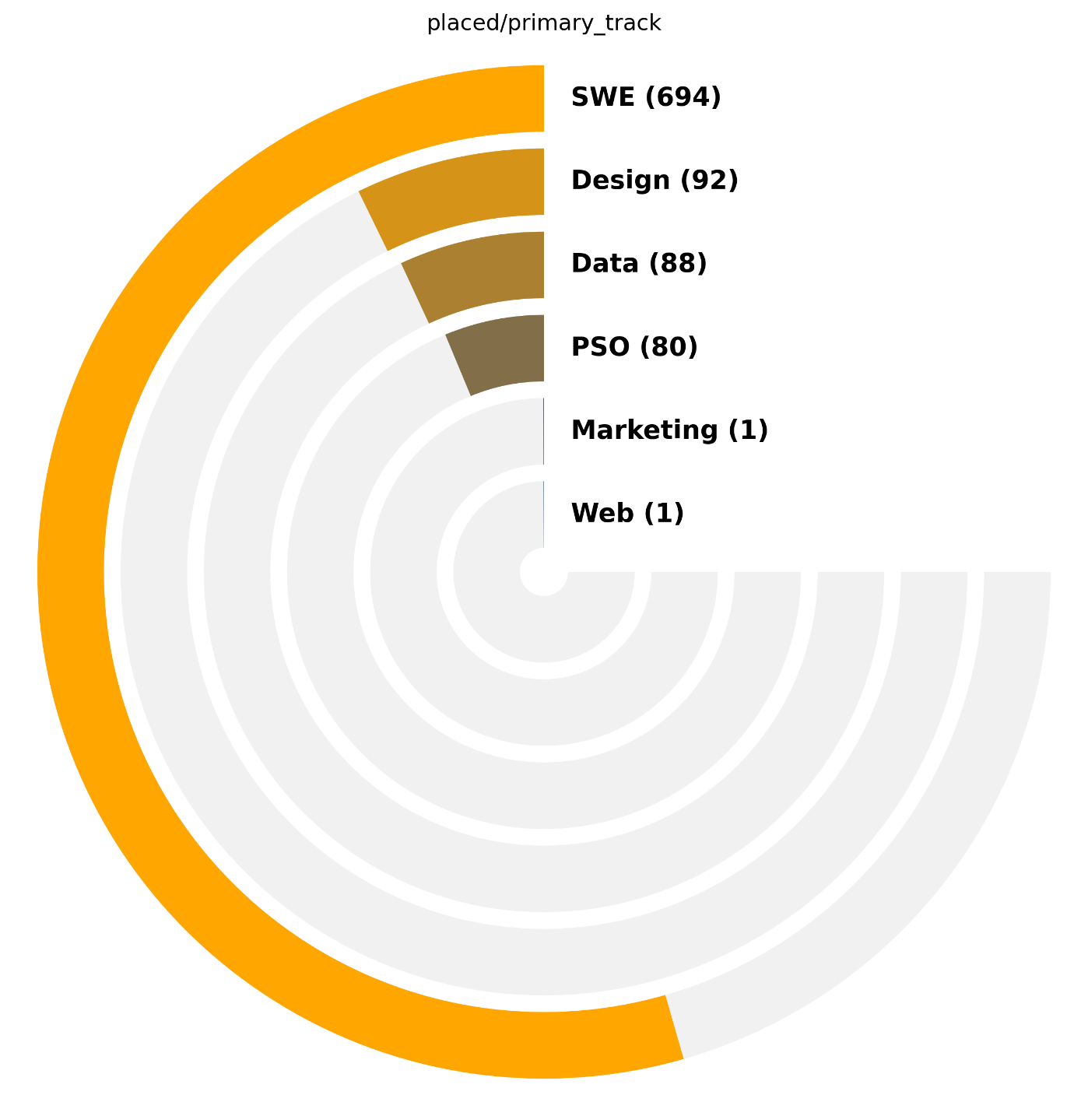
Explorer in primary track
Which group of primary tracks have more population?
Which primary track is more successful to find a job than others?

Slide 14
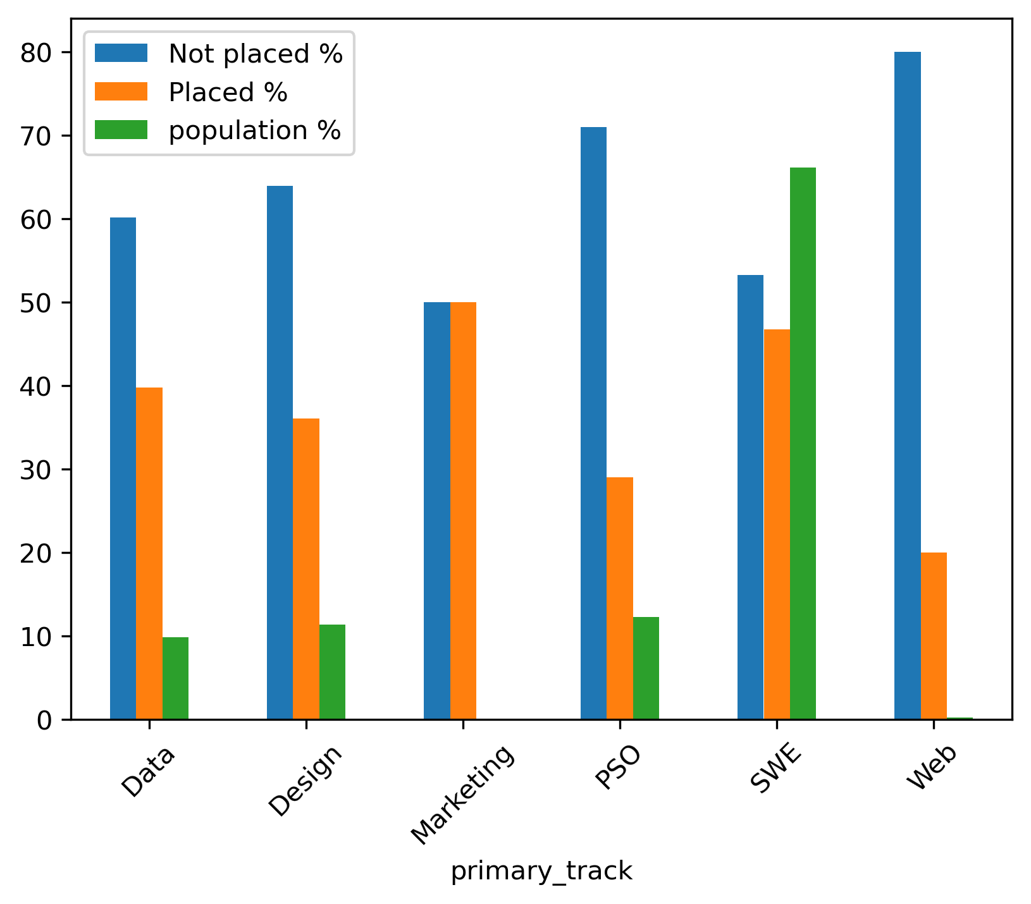
Explorer in primary track
The percentage of people being successful to find a job changes if the they are compared according to their population
Most successful
 | Data | Design | Marketing | PSO | SWE | Web
Not placed % | 60.2 | 63.9 | 50.0 | 71.0 | 53.3 | 80.0
Placed % | 39.8 | 36.1 | 50.0 | 29.0 | 46.7 | 20.0
population % | 9.8 | 11.4 | 0.1 | 12.3 | 66.2 | 0.2
Most popular
The number of people whose primary track is marketing only two, so this group should be ignored as a insufficient evidence

Slide 15
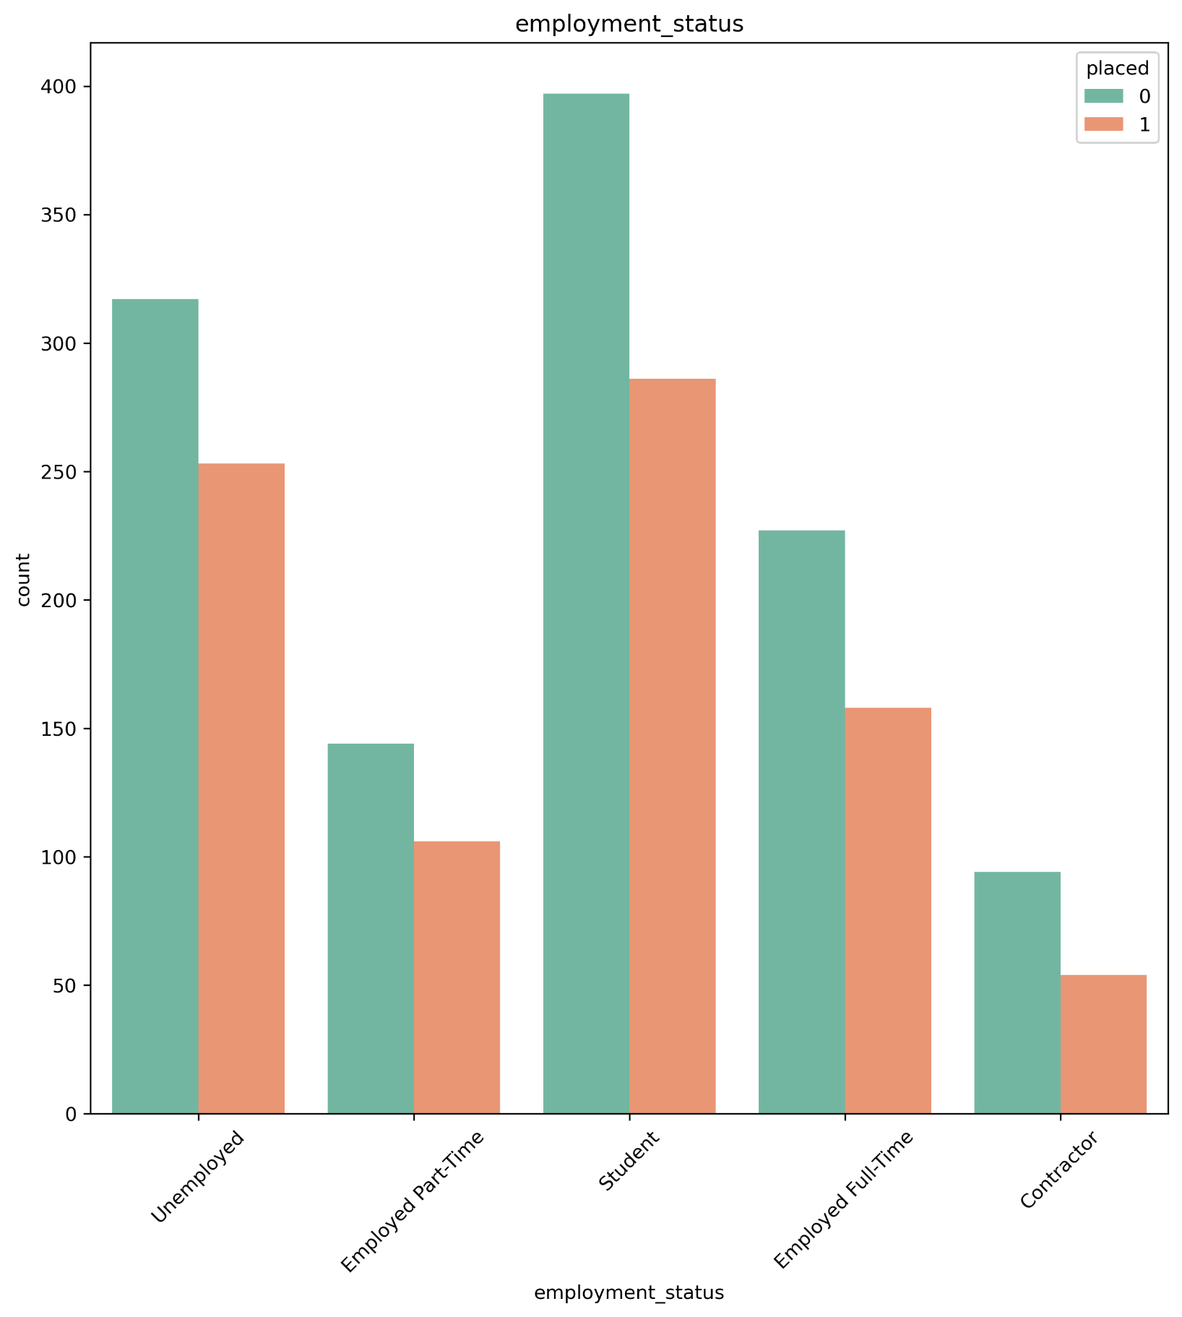
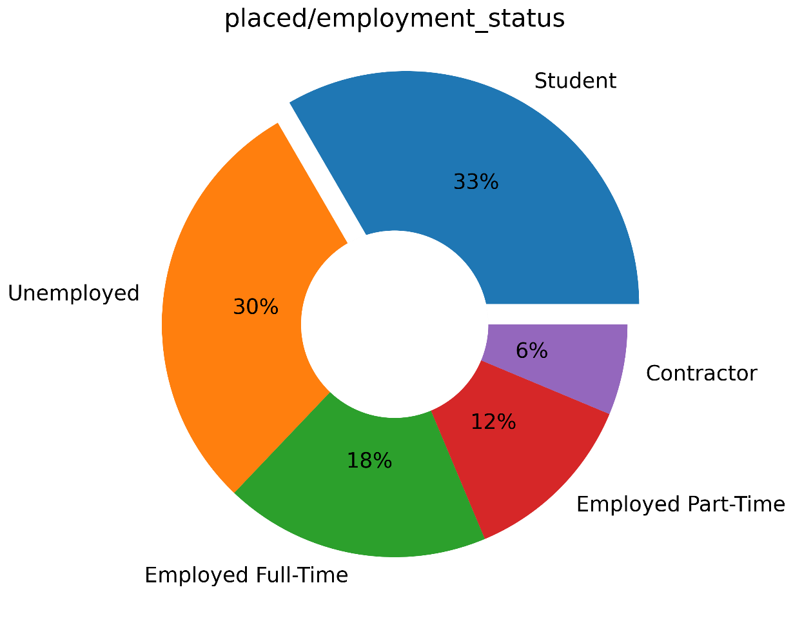
Explorer in employment status
Which group of people had more chance to find a career?
 | Contractor | Employed Full-Time | Employed Part-Time | Student | Unemployed
Not placed % | 63.5 | 59.0 | 57.6 | 58.1 | 55.6
Placed % | 36.5 | 41.0 | 42.4 | 41.9 | 44.4
population % | 7.3 | 18.9 | 12.3 | 33.5 | 28.0
Although the students made up the majority of people participating in Pathrise Program, people with part time job and unemployed people had a bit more chance to find a job

Slide 16
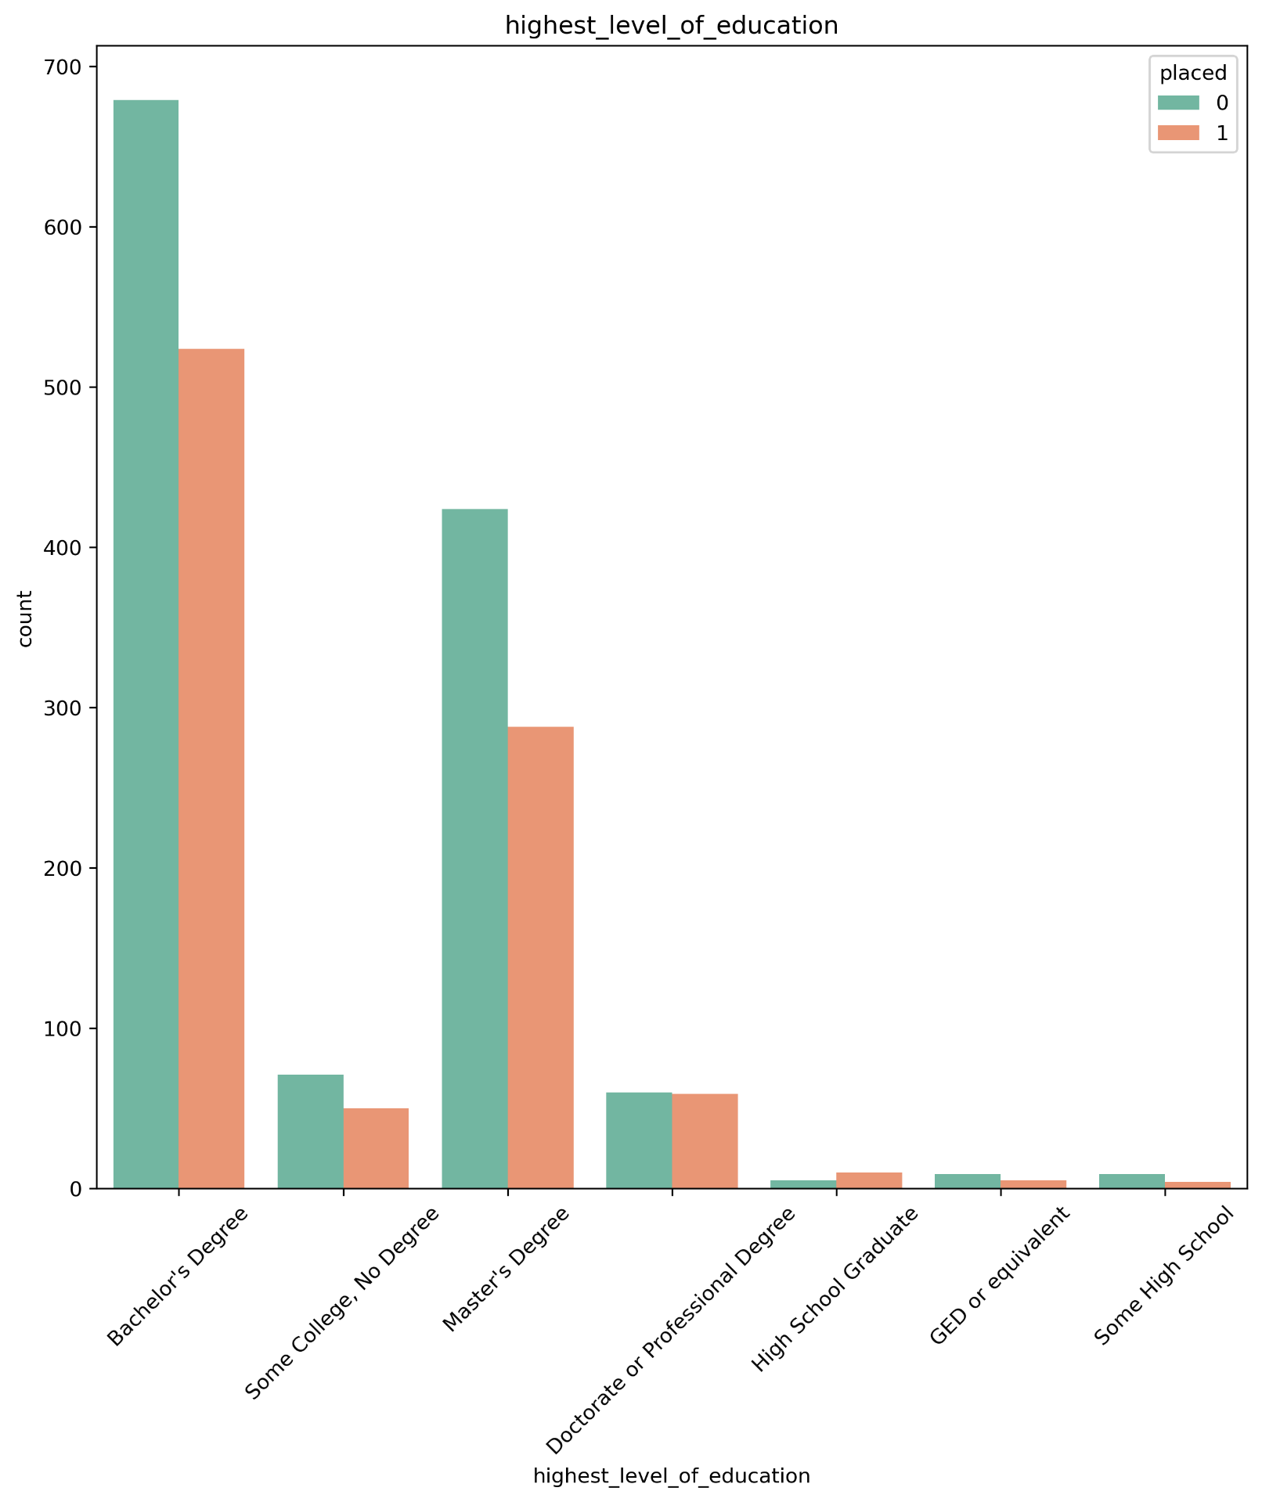
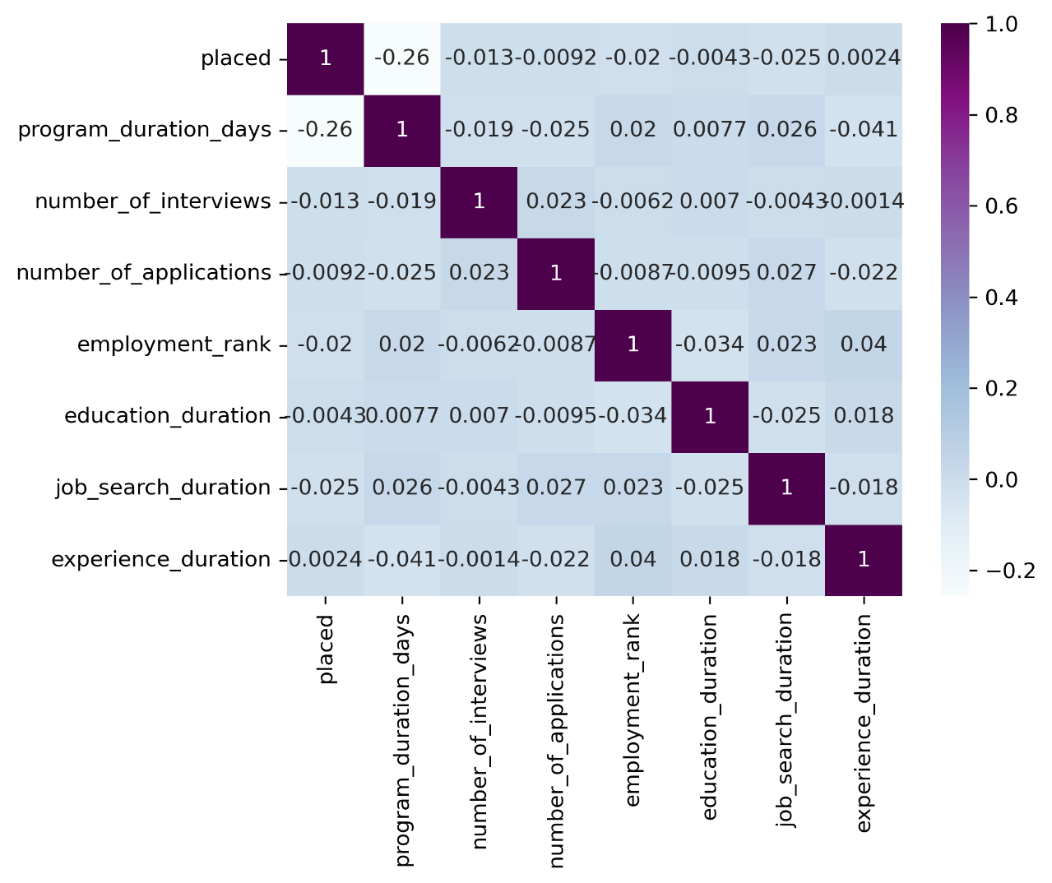
Explorer in highest level of education
How much can the education level help people find a job?
As is can be seen, different levels of education have not enough population to assess the influence of education level on the opportunity of finding a job. However, individuals with Bachelor’s and master degree made up the most number of people being successful to find a career
Heat map correlation plot shows very small negative number -0.0043 correlation coefficient between level of education and placed

Slide 17
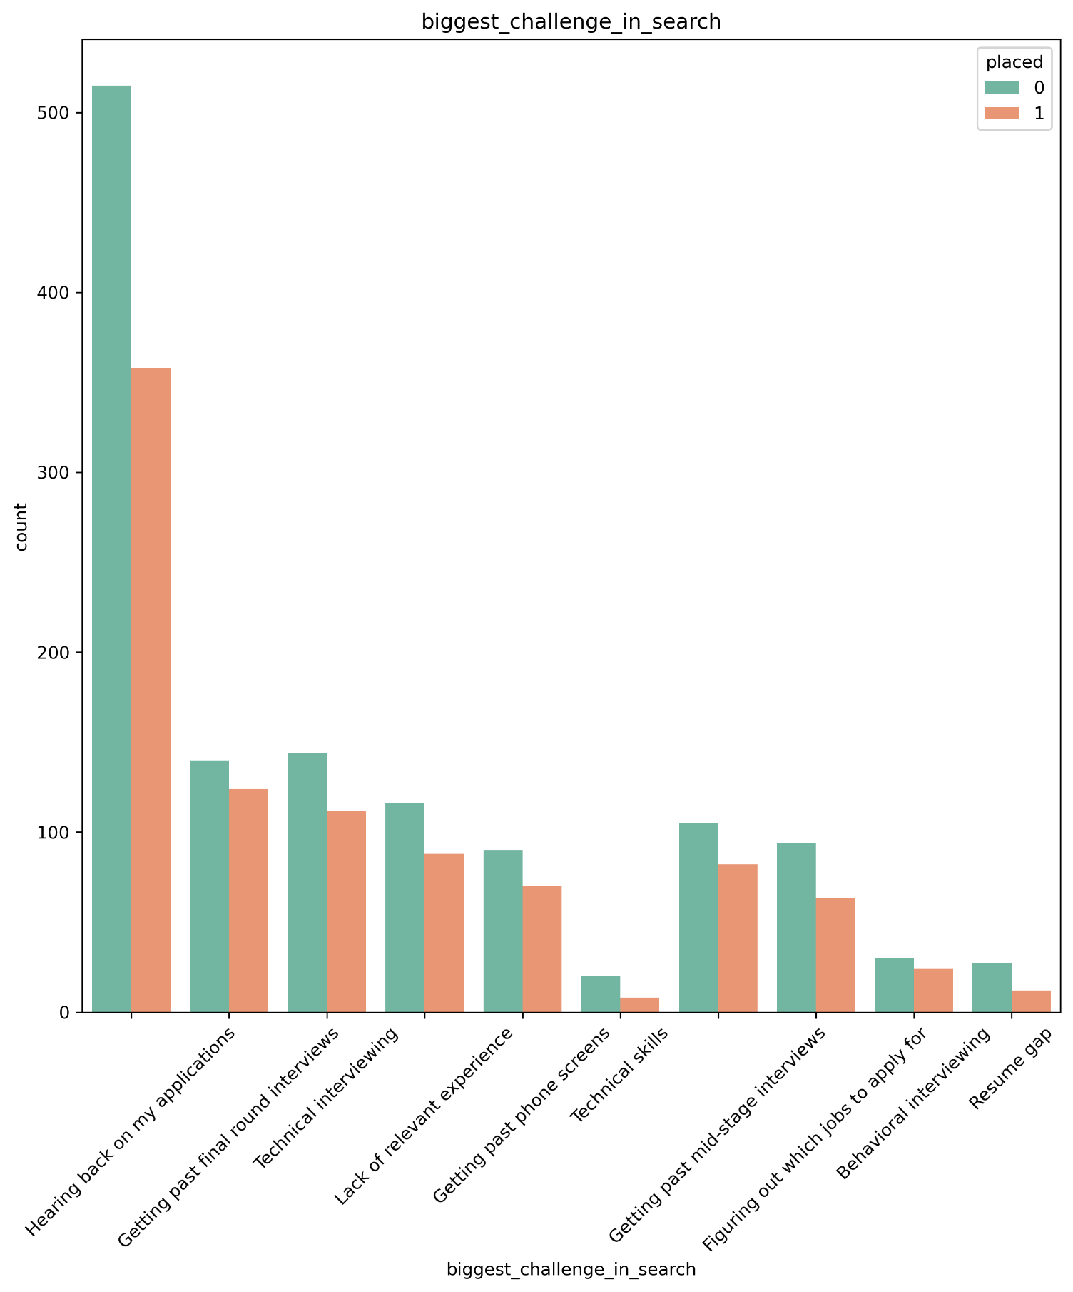
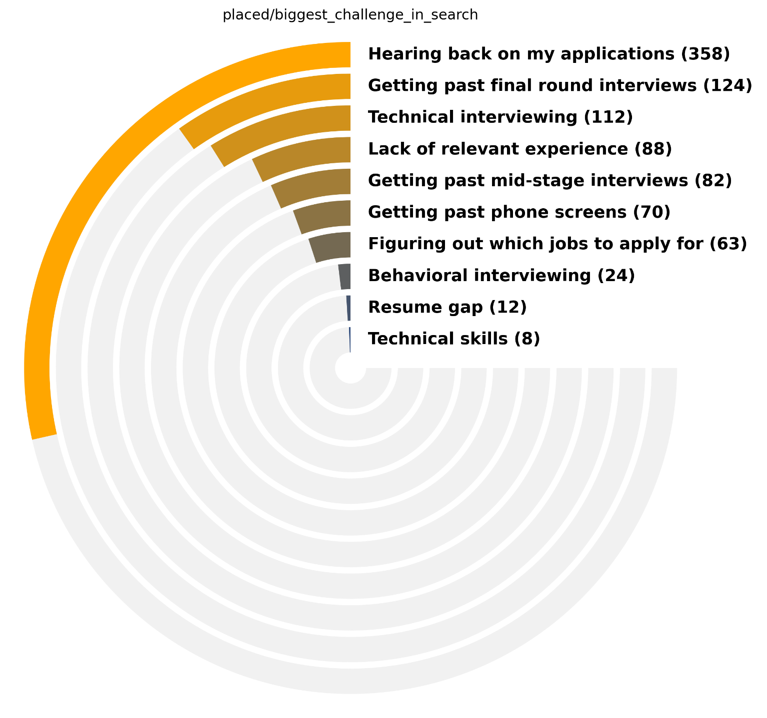
Explorer in biggest challenge in search
“Hearing back on my application” was the prevalent challenging issue for both groups (placed and not placed)

Slide 18
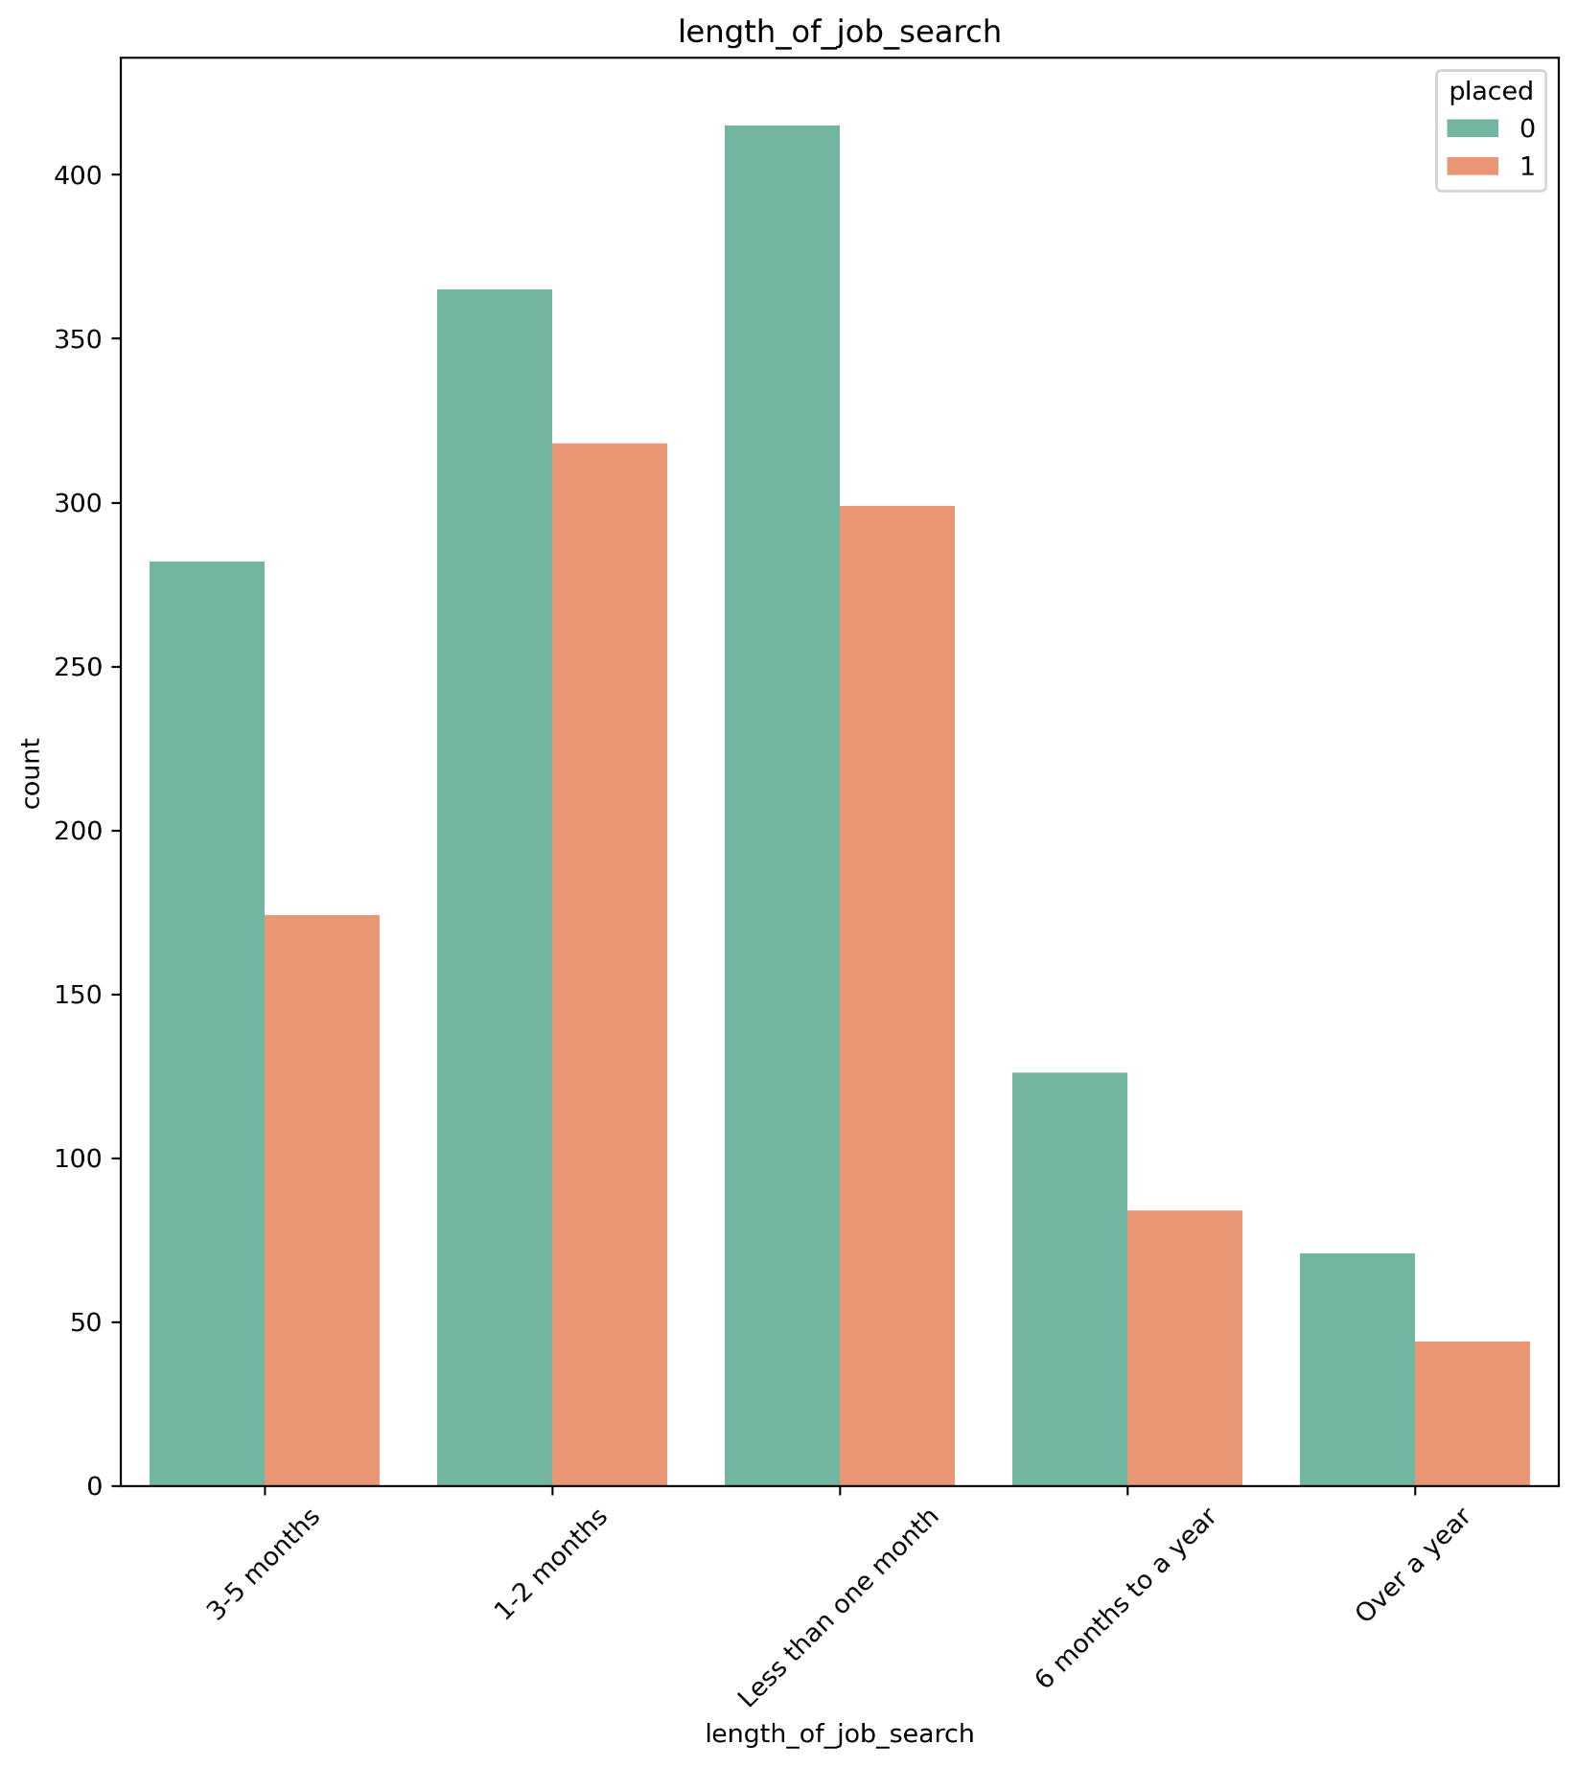
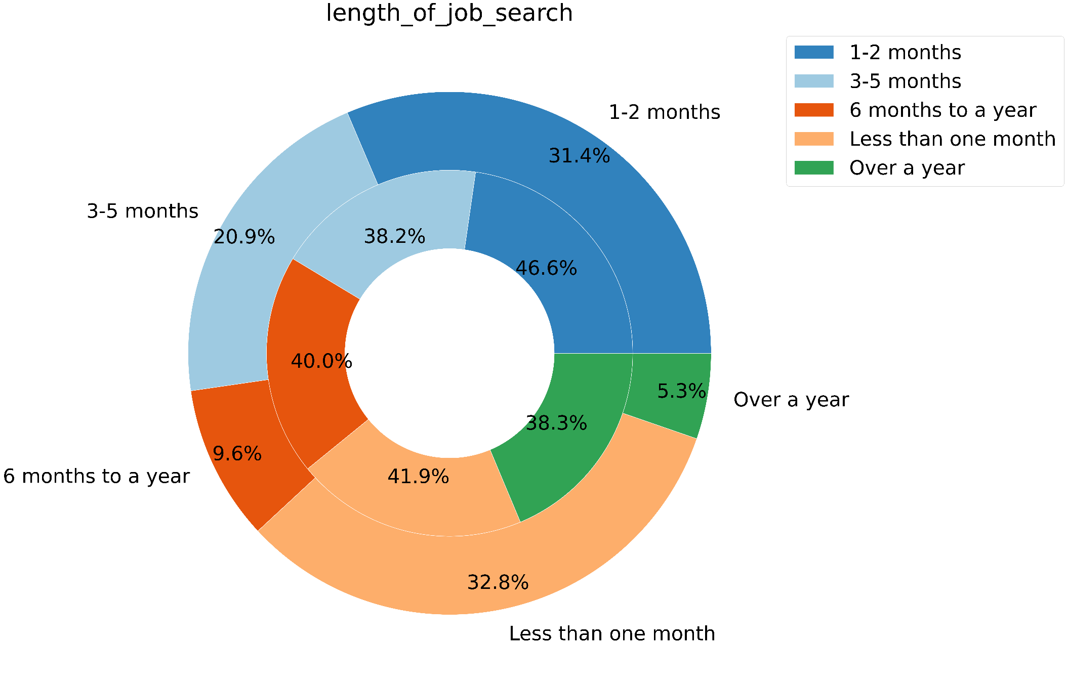
Explorer in length of job search
What is the most effective period of time to seek a job?
population
Placed
People who searched the job between 1 to 2 months had better performance. As it can be shown, the chance of people to find a job decreased after this time.

Slide 19
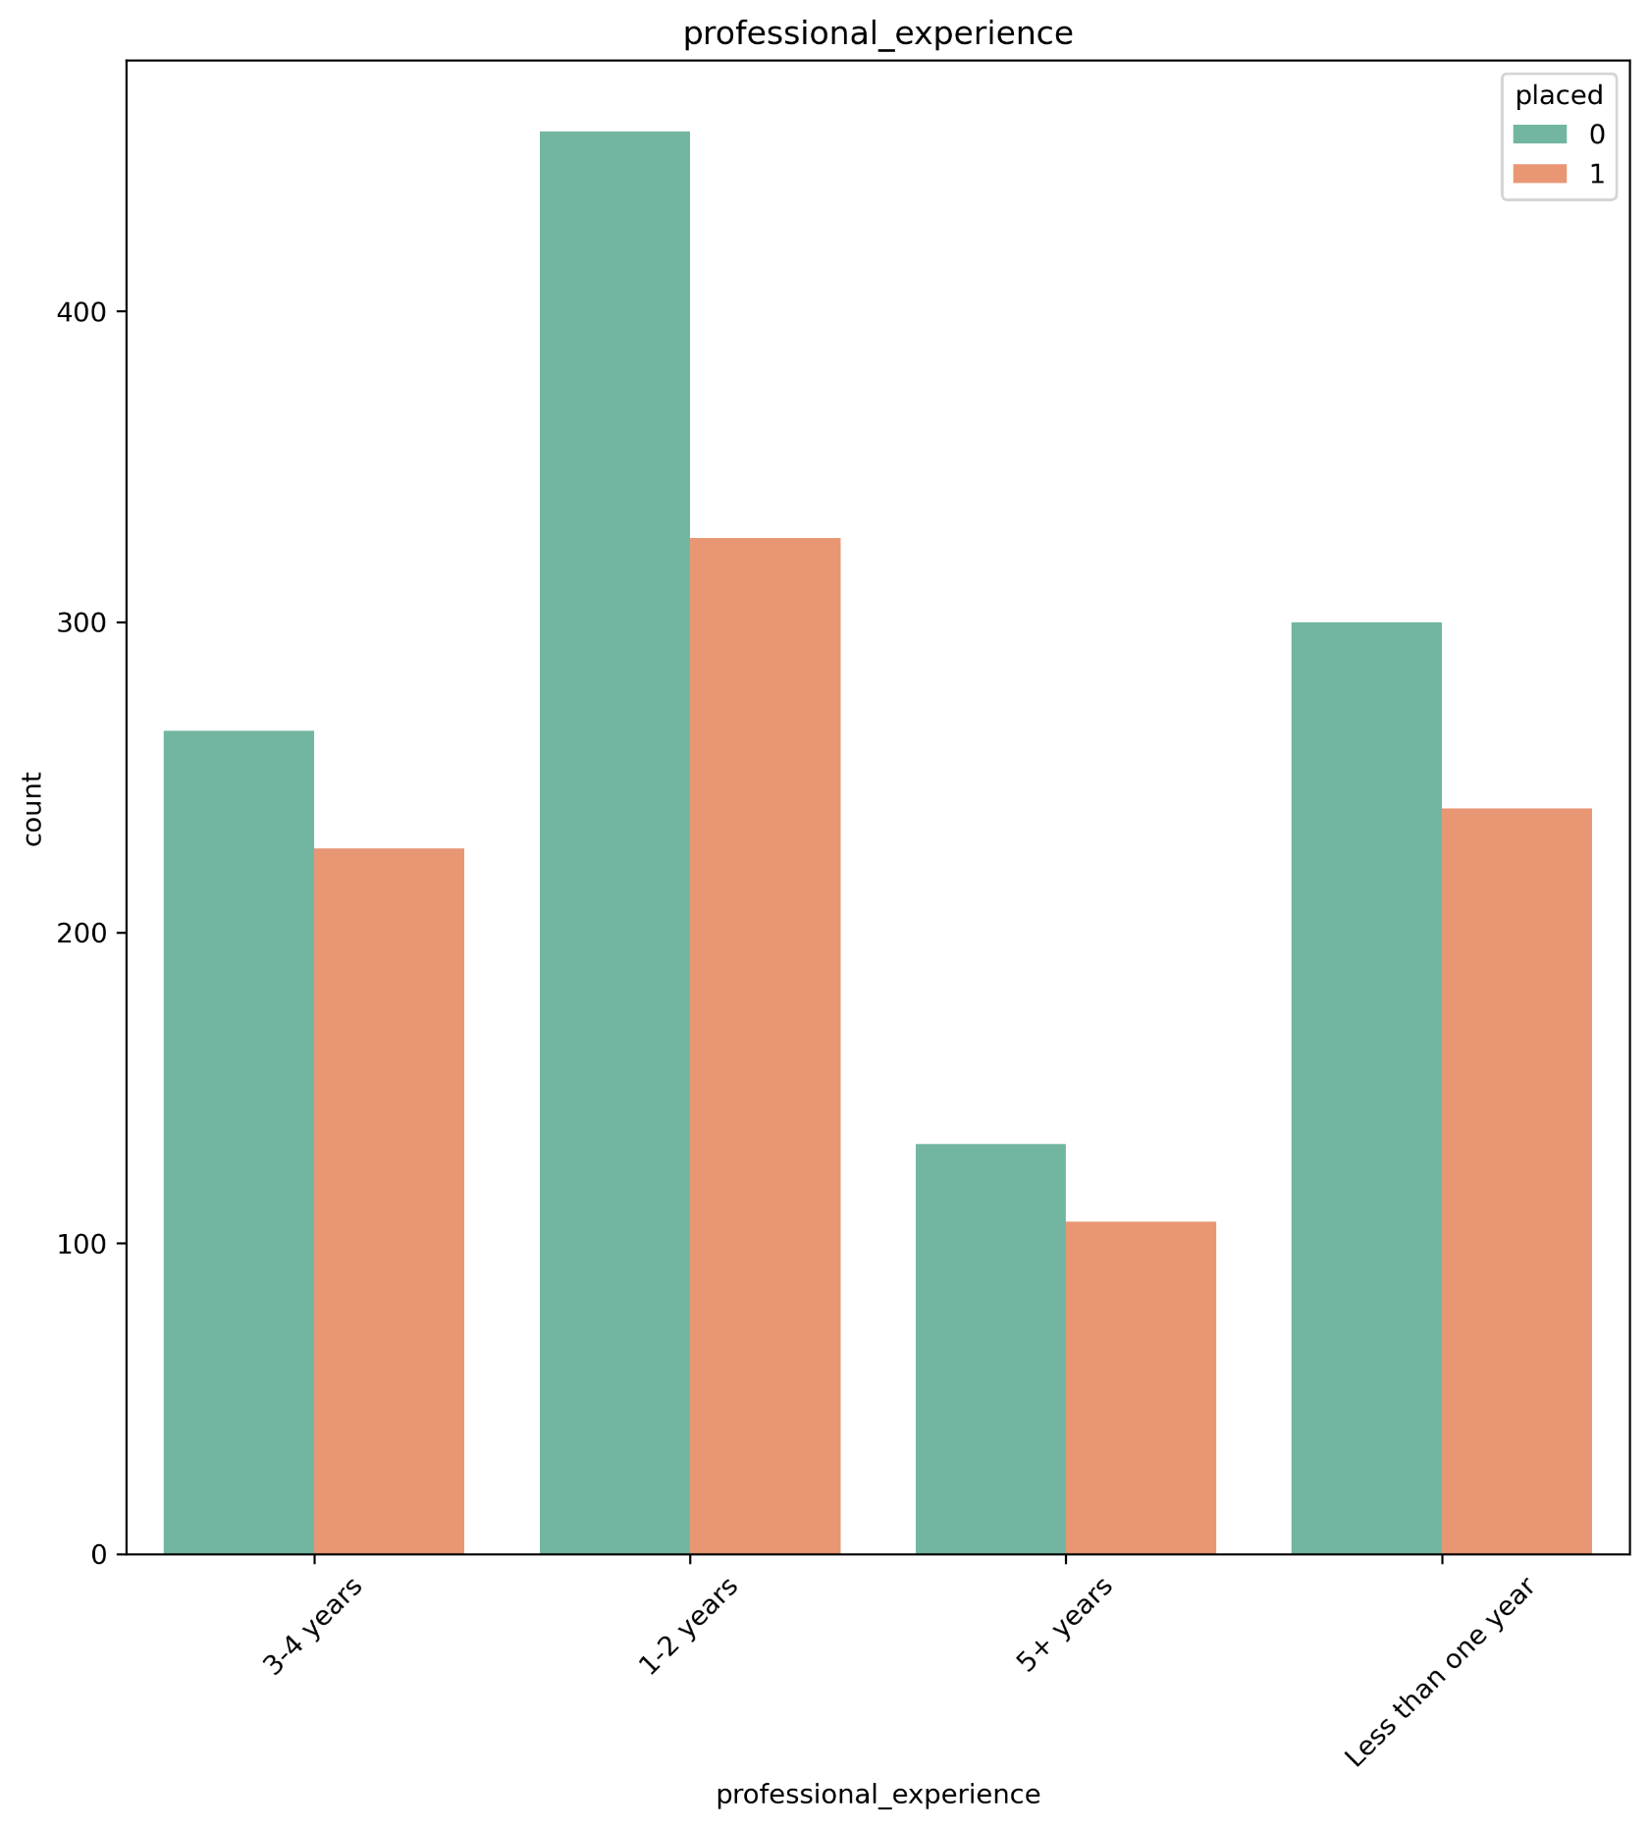
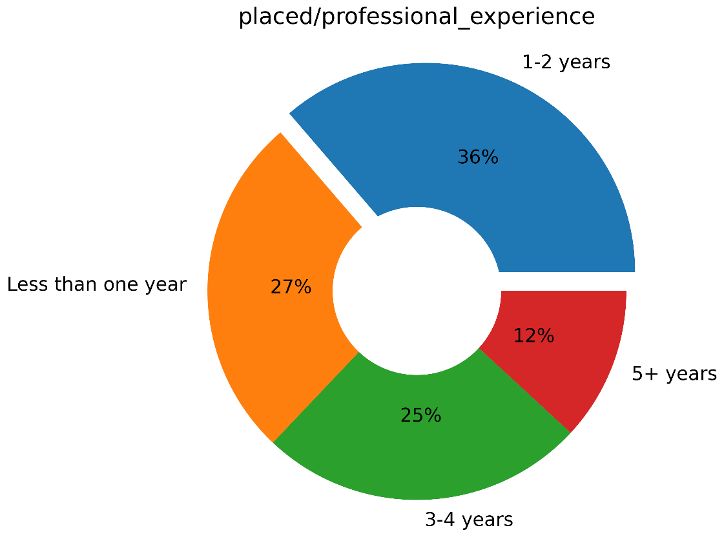
Explorer in professional experience
How much does people's professional experience help them find a job?
 | 1-2 years | 3-4 years | 5+ years | Less than one year
Not placed % | 58.3 | 53.9 | 55.2 | 55.6
Placed % | 41.7 | 46.1 | 44.8 | 44.4
population % | 38.2 | 23.9 | 11.6 | 26.3
Although people with 1 to 2 years of professional experience were the largest group of people who found employment, people with more than 5 years of experience or less then one year were more successful compared to their population

Slide 20
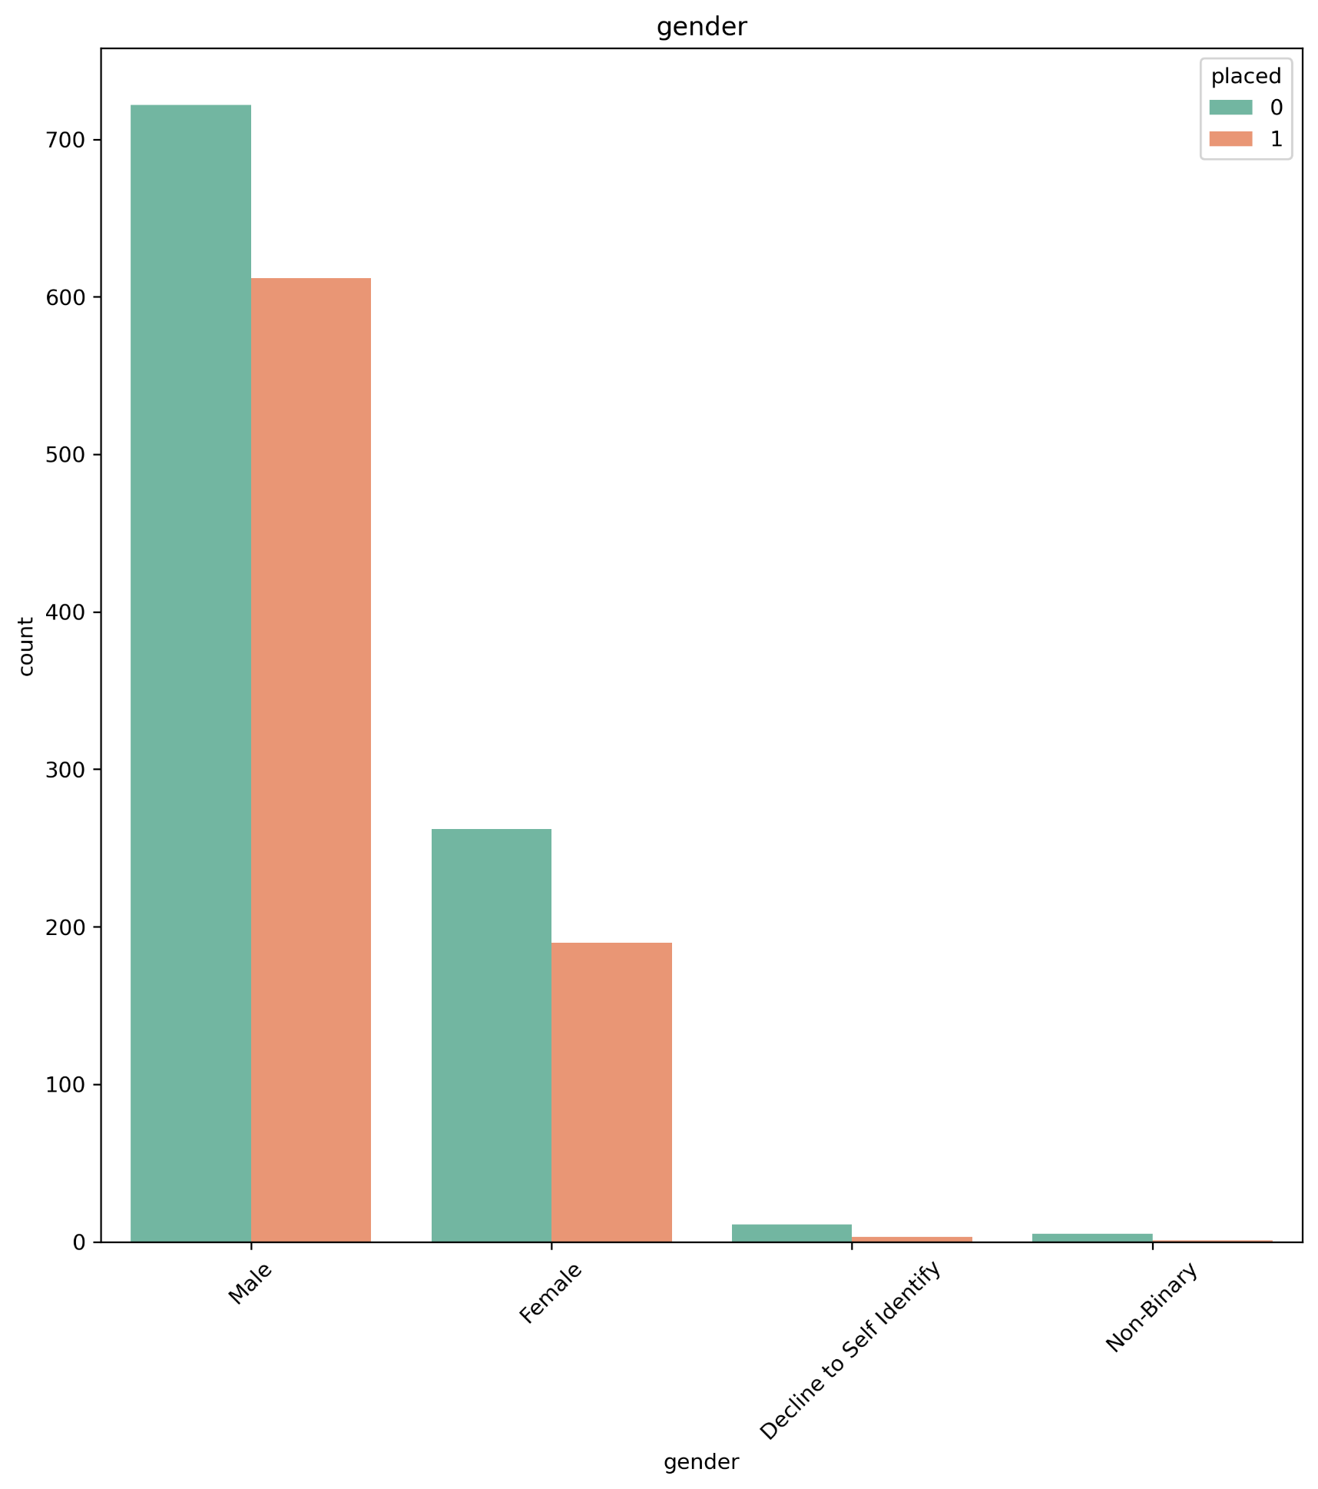
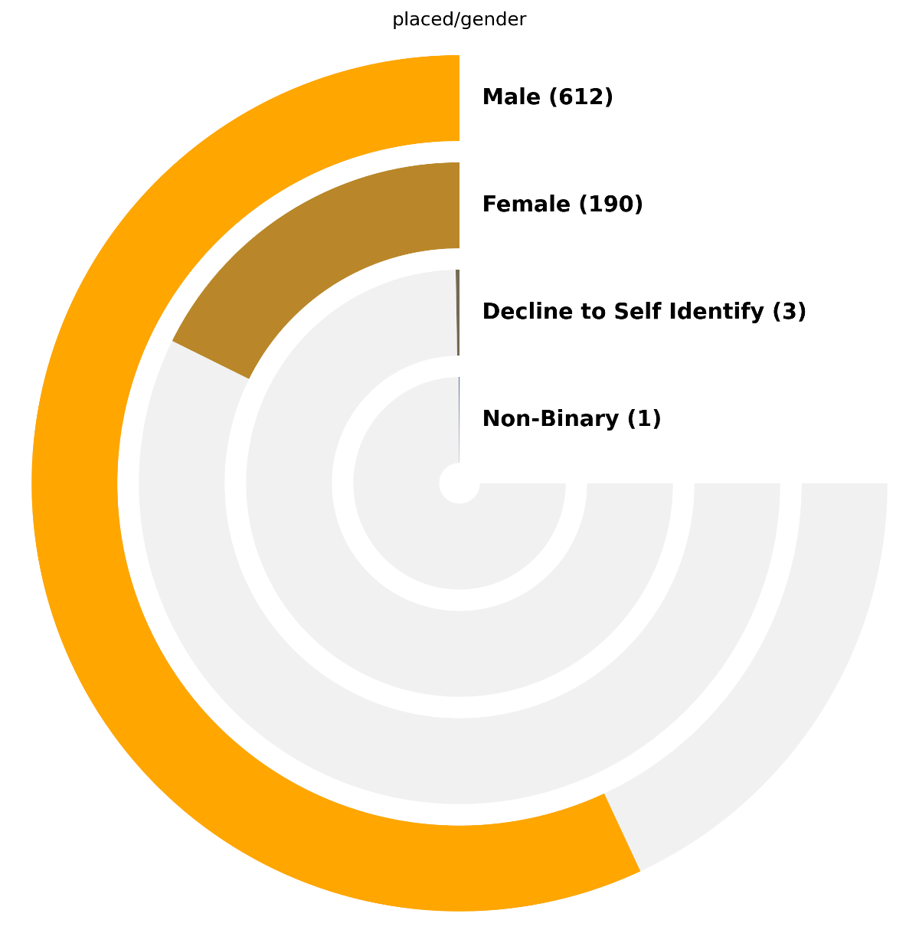
Explorer in gender
Does gender impact on people's chances of finding a job?
 | Decline to Self Identify | Female | Male | Non-Binary
Not placed % | 78.6 | 58.0 | 54.1 | 83.3
Placed % | 21.4 | 42.0 | 45.9 | 16.7
population % | 0.8 | 25.0 | 73.9 | 0.3
As it can be seen, males are the largest group of people participating in the Pathrise program. However , the percentage of men and women who succussed to find a job are virtually equal with respect to their population, and there is insufficient evidence for other groups

Slide 21
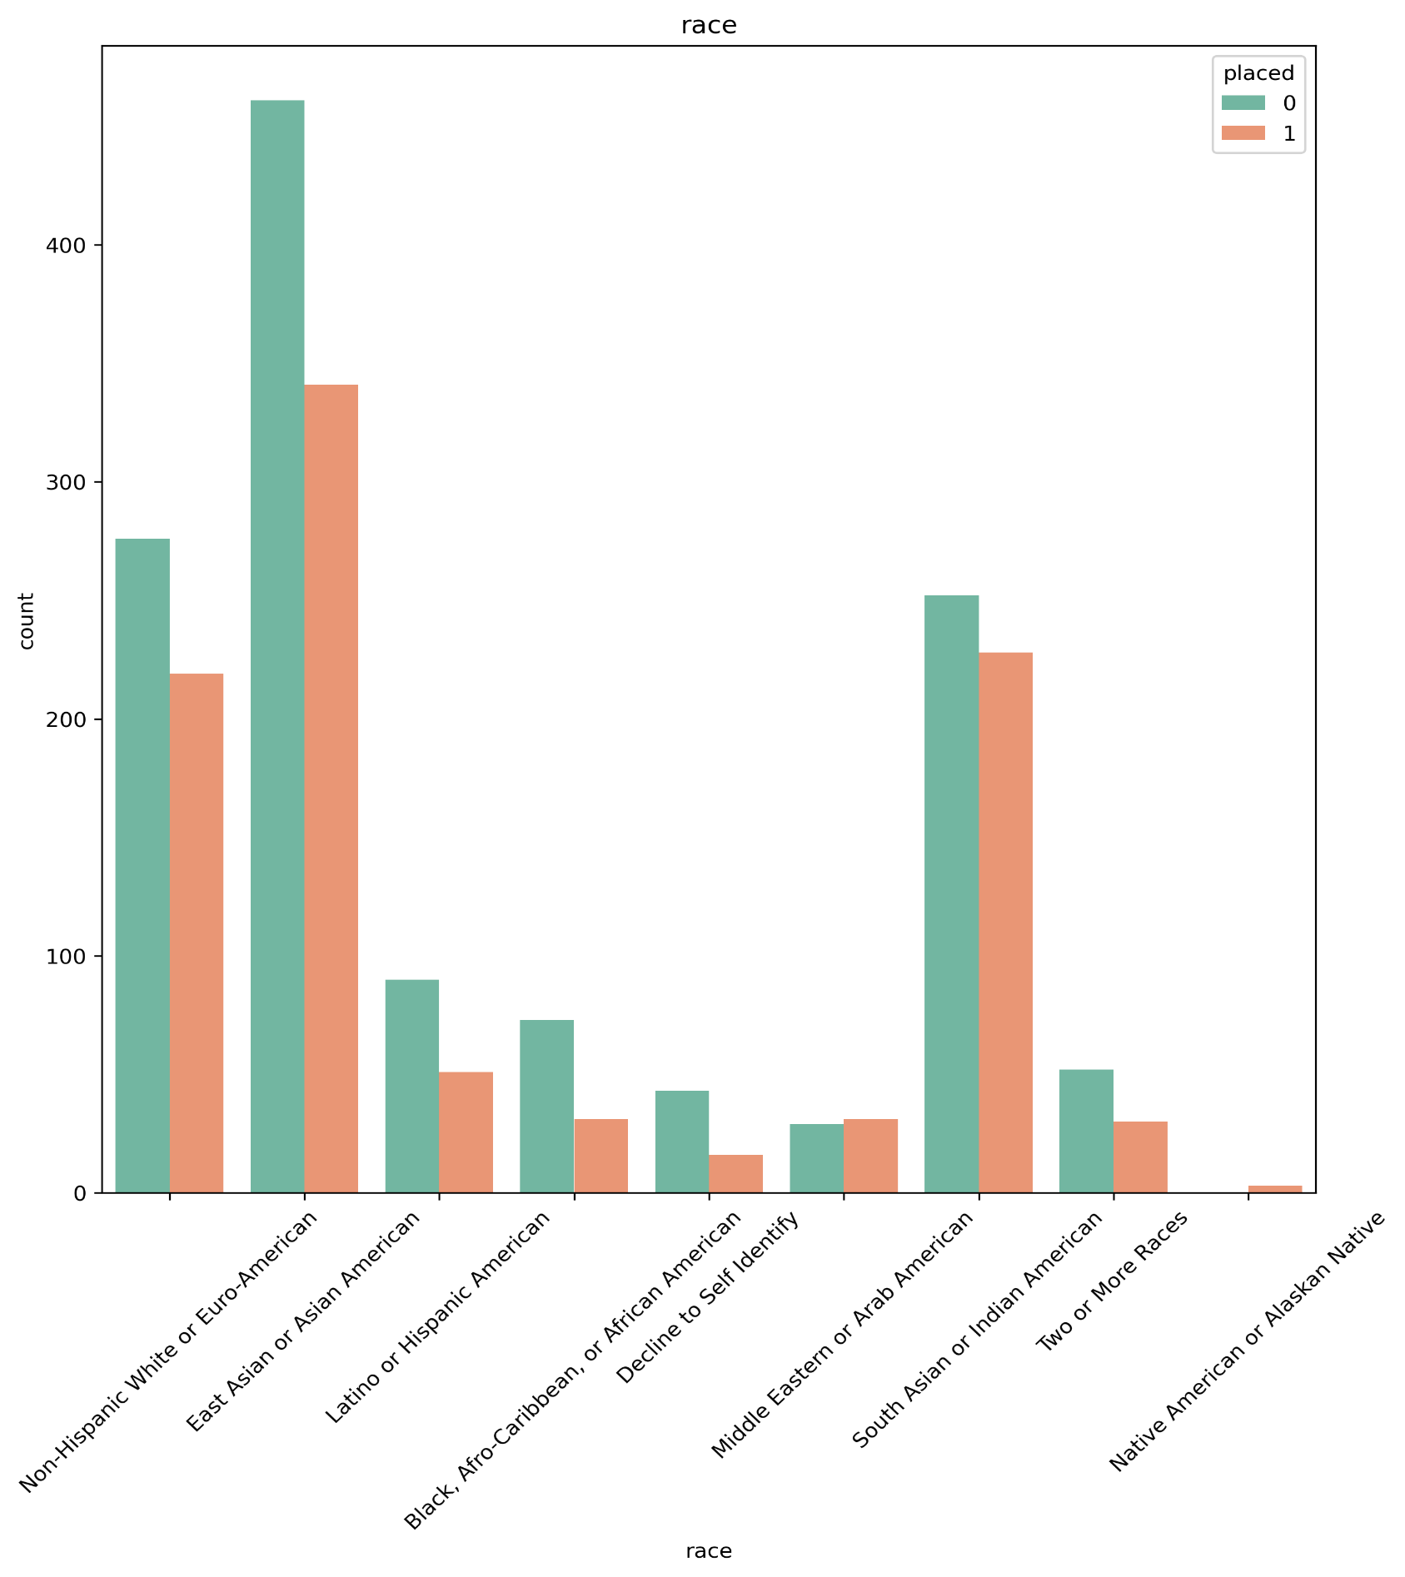
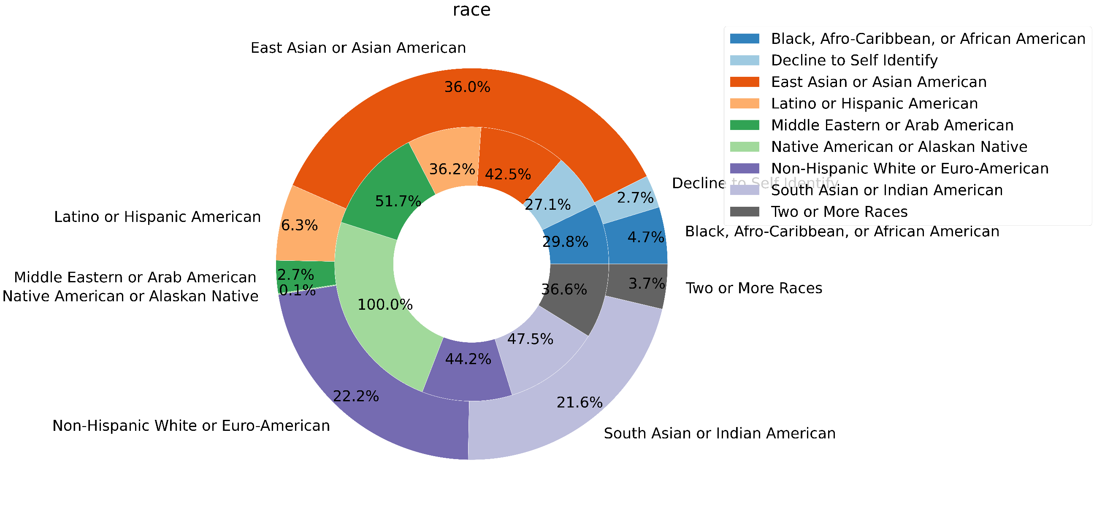
Explorer in race
Is there any racial discrimination for employment?
East Asian or Asian American, Non-Hispanic White or Euro-American and South Asian or Indian American are the most people taking part in the program respectively. However, the opportunity for all races are almost equal comparing to their population, and there is no evidence for discrimination.

Slide 22
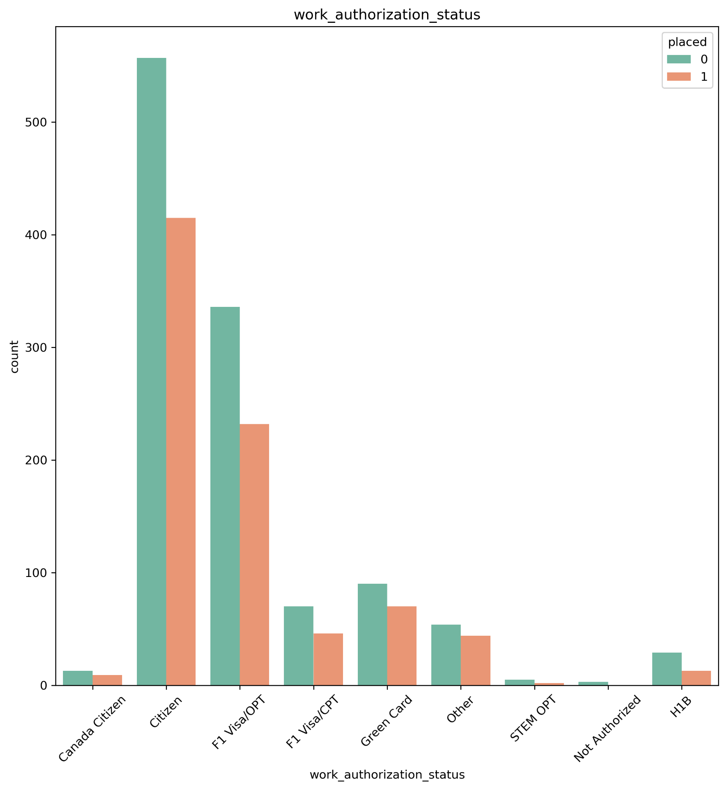
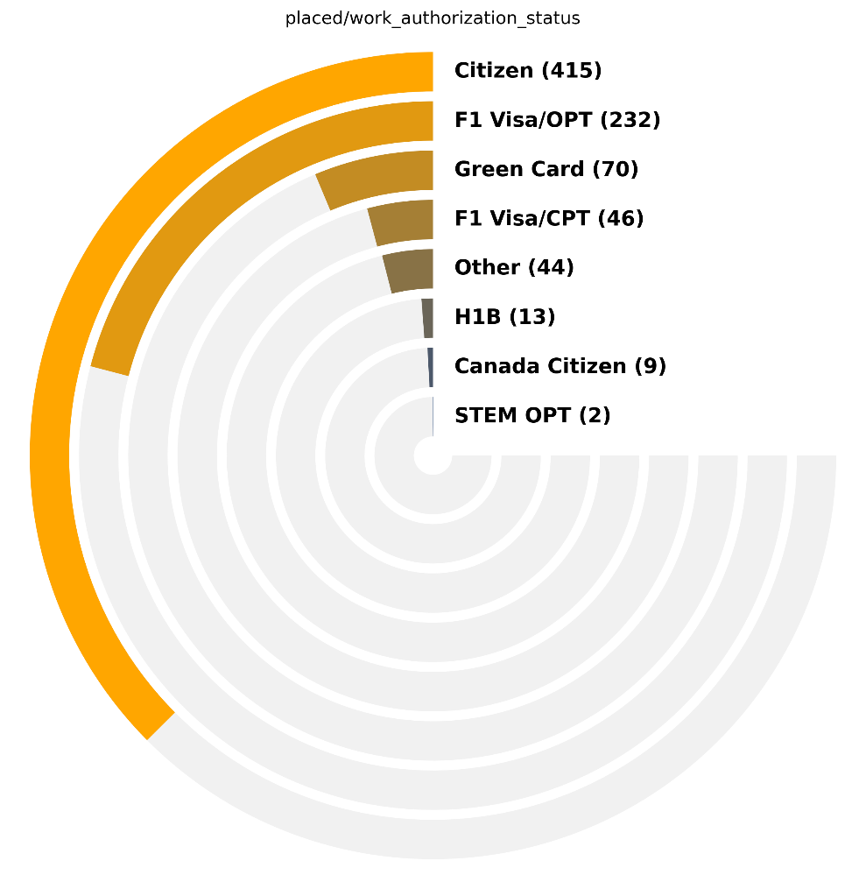
Explorer in work authorization status
How much does the authorization status affect people’s chance of finding a job?
 | Canada Citizen | Citizen | F1 Visa/CPT | F1 Visa/OPT | Green Card | H1B | Not Authorized | Other | STEM OPT
Not placed % | 59.1 | 57.3 | 60.3 | 59.2 | 56.3 | 69.0 | 100.0 | 55.1 | 71.4
Placed % | 40.9 | 42.7 | 39.7 | 40.8 | 43.8 | 31.0 | 0.0 | 44.9 | 28.6
population % | 1.1 | 48.9 | 5.8 | 28.6 | 8.0 | 2.1 | 0.2 | 4.9 | 0.4
As the graphs show, American citizens were the most group of people taking part in the program, and they had high chance to find a job. However people with F1 visa, Green Card and Canadian Citizen had virtually similar chance. The least chance was related to people with STEM OPT visa.
If you have no authorization , there is no chance to find a job

Slide 23

Explorer in program duration days
1. How much can the Pathrise program help the people find a job?
There is no meaningful difference between average time which successful people and unsuccessful people spend on Pathrise Program
Mean differences between two groups shows Program duration is not critical factor

Slide 24
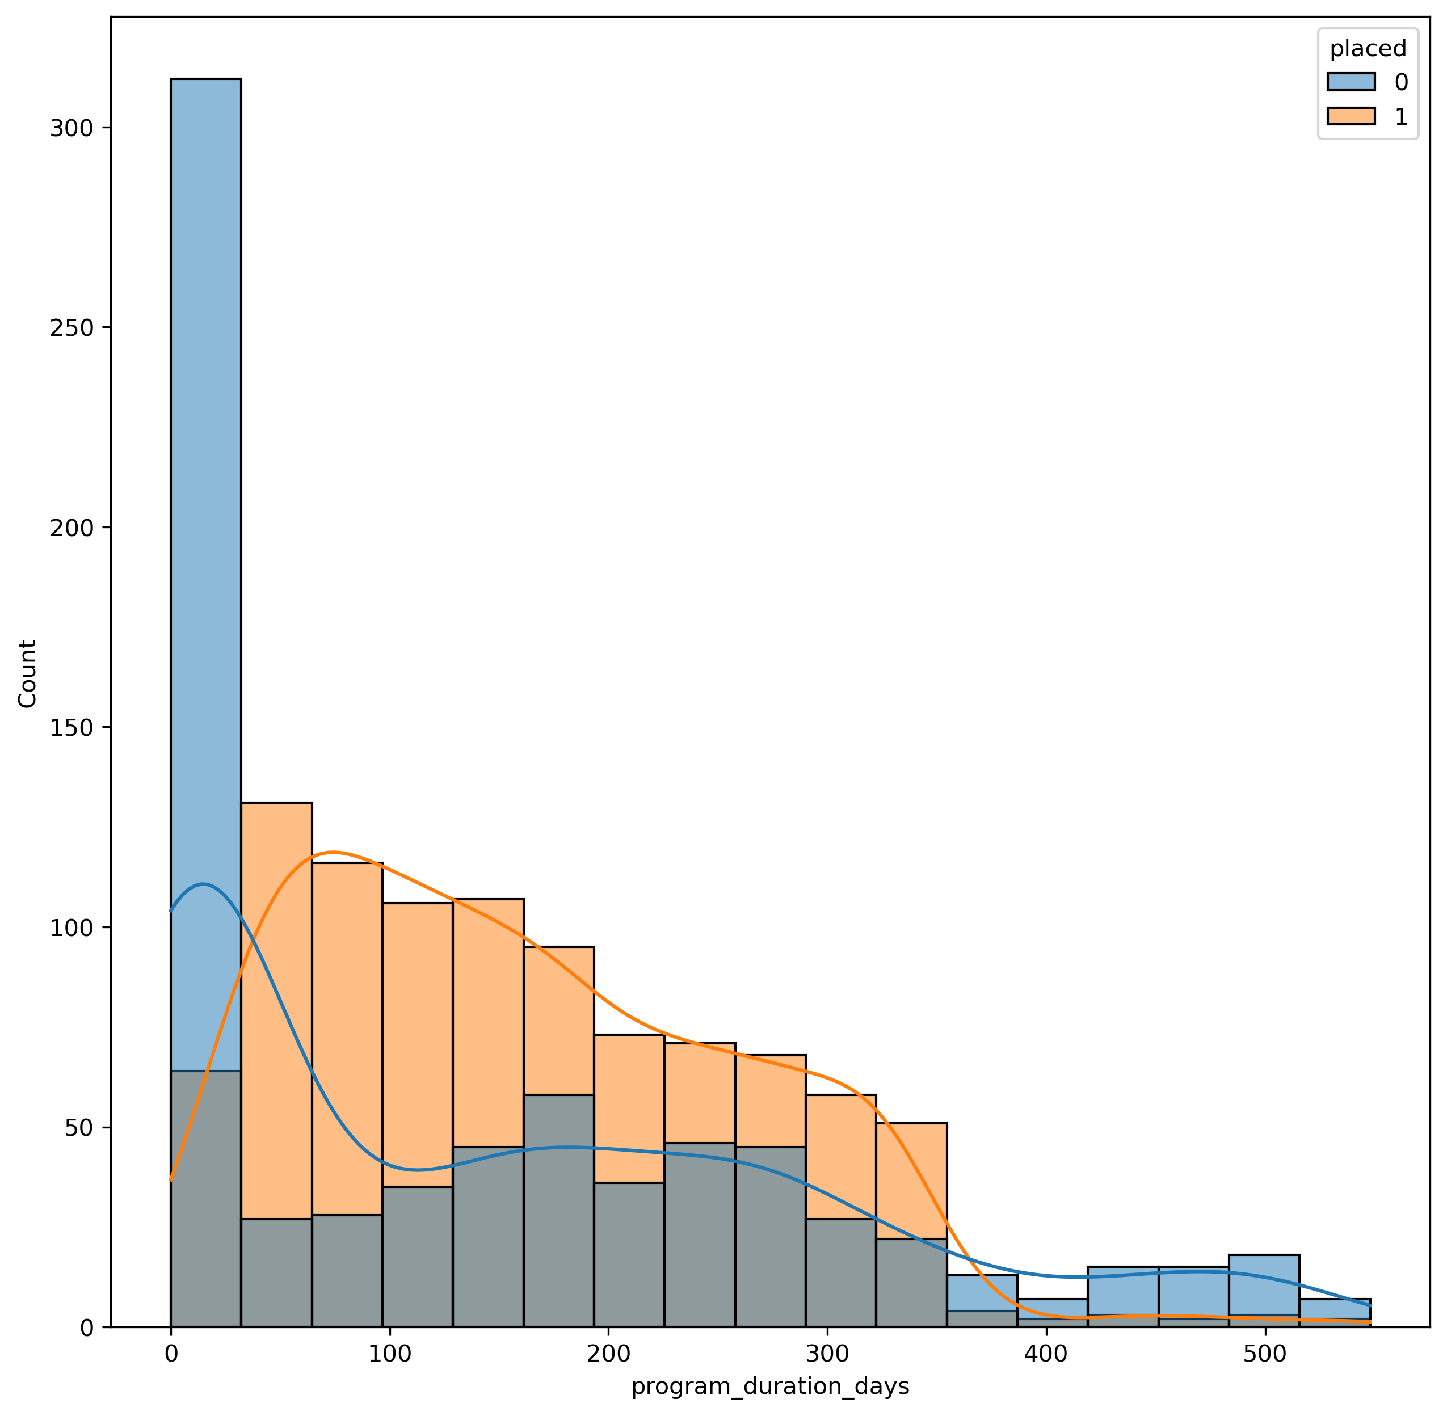
Explorer in program duration days
2. How much should the people spend time on Pathrise program?
Effectiveness of program decreases after almost 100 days
Effective period

Slide 25
Summary of EDA results
Software engineering (SWE) was the most common primary track and people with this primary track was the most successful group.
Employed part-time , unemployed and student People were the most group of people who find a job respectively
There is insufficient evidence to show the relationship between level of education and opportunity of finding a job. However, correlation examination shows vary small negative correlation coefficient.
“Hearing back on my application” was the prevalent challenging issue for both groups (placed and not placed)
People who searched the job between 1 to 2 months had better performance.
People with more than 5 years of experience or less then one year were more successful compared to their population

Slide 26
Summary of EDA results
The percentage of men and women who succussed to find a job are virtually equal with respect to their population
The opportunity for all races are almost equal comparing to their population, and there is no evidence for discrimination.
American citizens were the most group of people taking part in the program and they had high chance to find a job. However people with F1 visa, Green Card and Canadian Citizen had virtually similar chance. If you have no authorization, there is no chance to find a job
Following the Pathrise program in 100 days have remarkable effect to increase the opportunity of people to find a job.

Slide 27

Performing Machine learning

Slide 28
Machine learning
There are two questions which are aimed to answer it by preparing supervised machine learning models
Preparing a model would be able to predicting whether or not someone participating in Pathrise program would be successful to find a job. This a classic supervised classification machine learning .
Training a model would be able to predicting how long a person participating in Pathrise program would find a job. This is classic regression machine learning

Slide 29
Process of preparing a machine learning model
Define the problem
“Placed” column is target column for classification model
Preparing Data
Working with missing values
Select the best model
Choosing different models
Setting different hyper-parameters for each model
Candidates for classification model
Setting Hyper parameters
Convert categorical values to numerical values
Working with outliers
Standardizing the values
Decision tree
Super vector machine
K nearest neighborhood
Training models
Training models by taring dataset and applying grid search to find out the best hyperparameter
Evaluating models
confusion matrix
Splitting dataset
Dataset is splited to two dataset, training and test dataset
A part of the data which the value of "placed" column form them is
program duration days is the target column for regression model
Candidates for regression model
logistic regression
Linear Regression
Support Vector Regression
Decision Tree Regression'
classification metrics
ROC curve
Regression metrics
Accuracy
Recall
Precision
F1-score
MAE
MSE
RSME

Slide 30
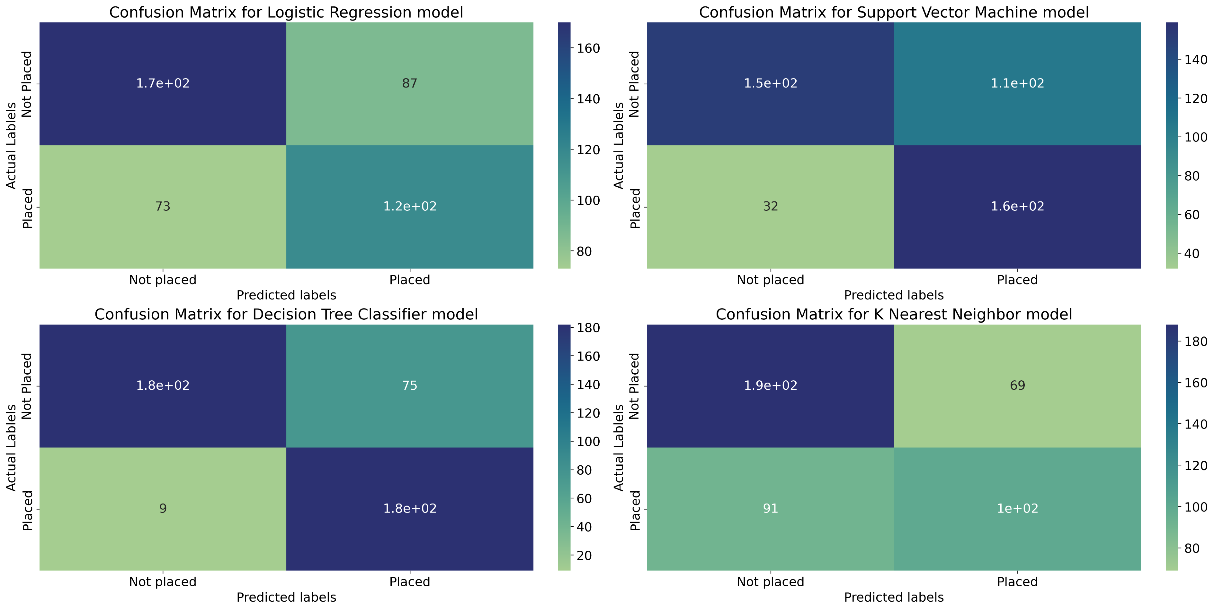
Classification results
Comparing results of models' confusion matrix

Slide 31
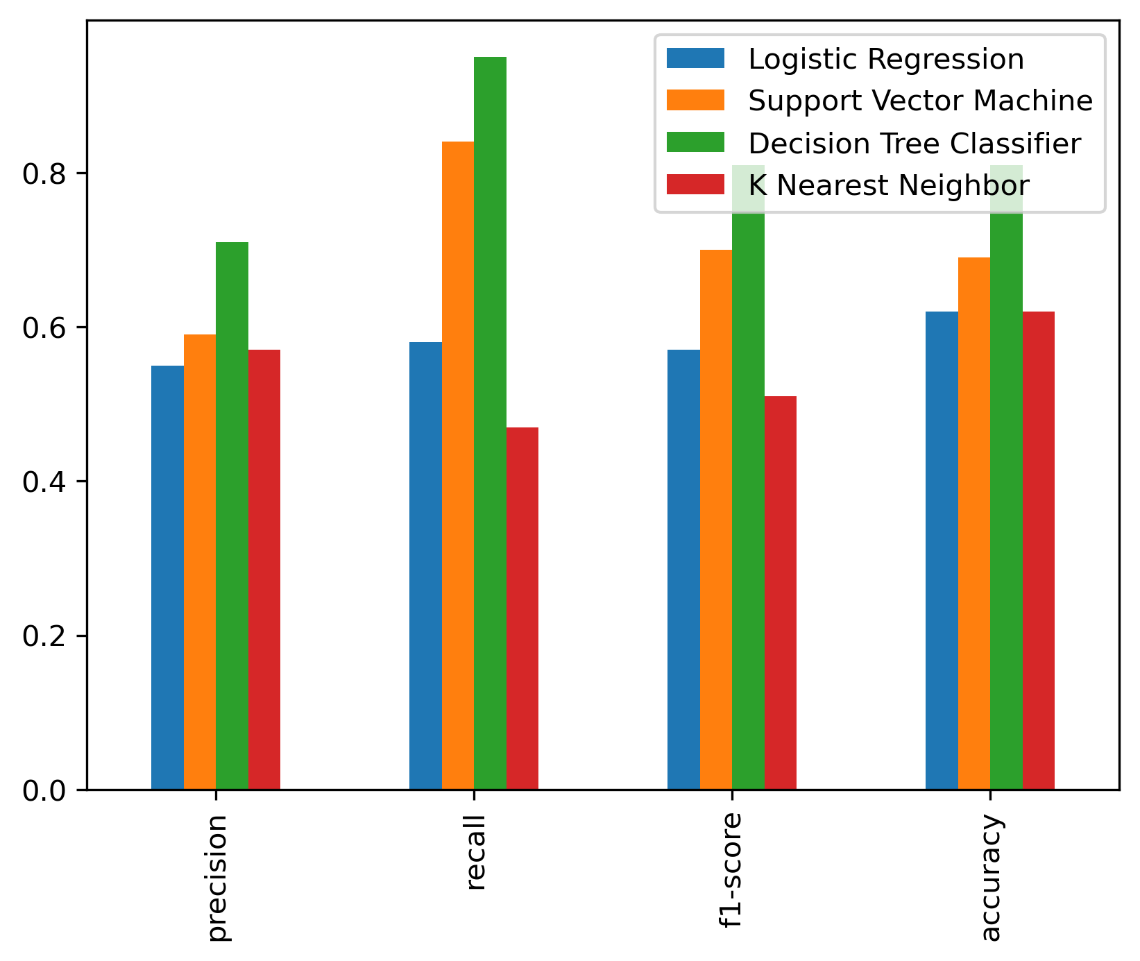
Classification results
Comparison of different metrics for each model in “placed=1” state
 | Logistic Regression | Support Vector Machine | Decision Tree Classifier | K Nearest Neighbor
precision | 0.58 | 0.6 | 0.71 | 0.59
recall | 0.62 | 0.83 | 0.95 | 0.52
f1-score | 0.6 | 0.7 | 0.81 | 0.56
accuracy | 0.64 | 0.69 | 0.81 | 0.64
As it can be seen decision tree shows the least error and the best accuracy

Slide 32
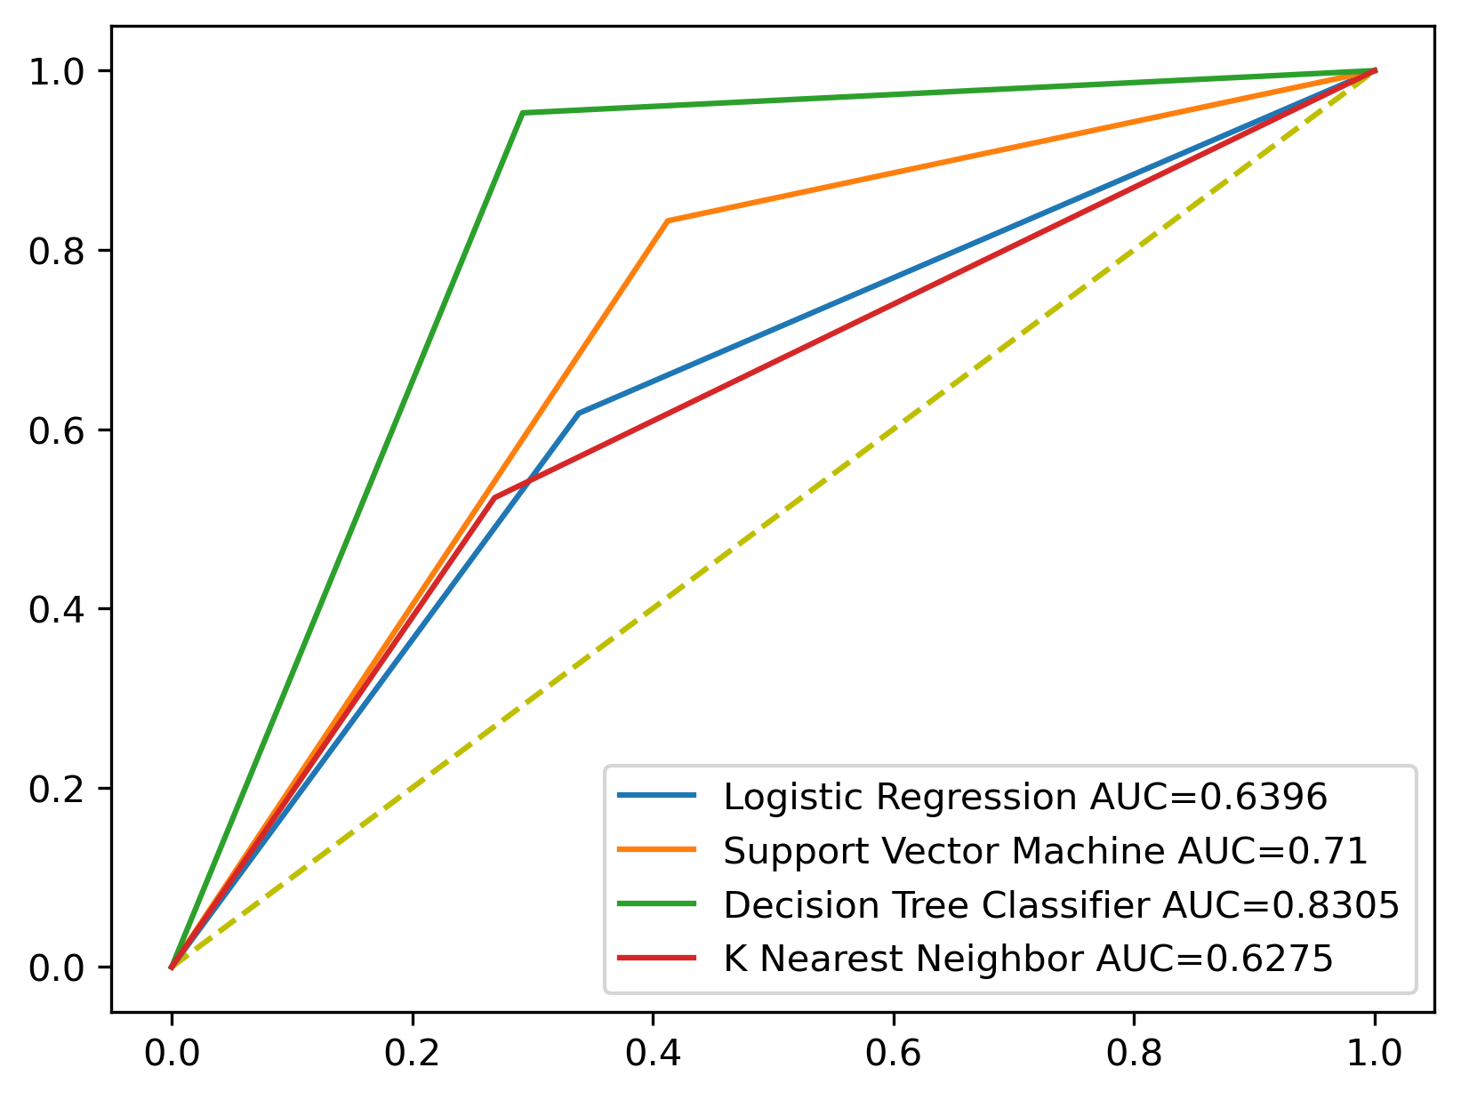
Classification results
Comparison of ROC curve for each model in “placed=1” state
The area under curve (AUC) for decision tree model is more than others and it shows better performance to predict and answer our question.

Slide 33
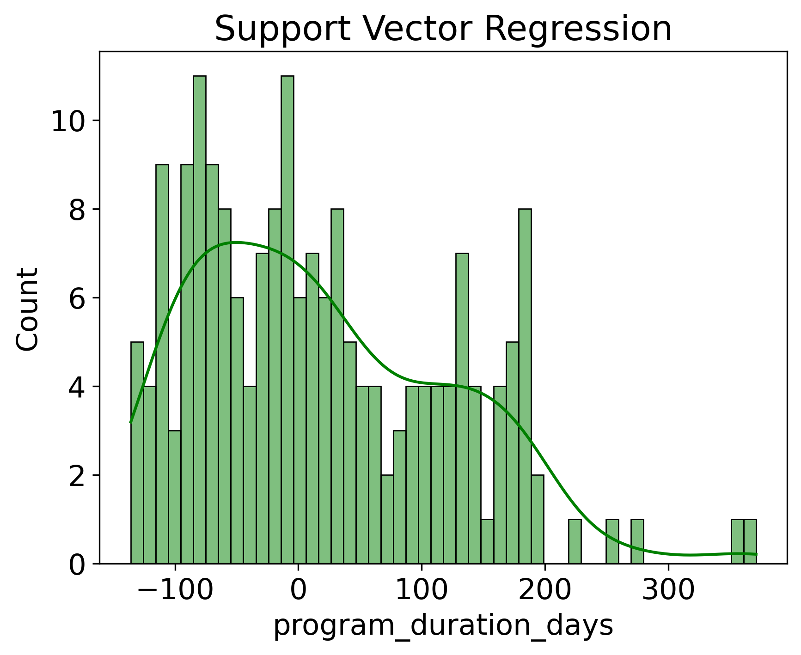
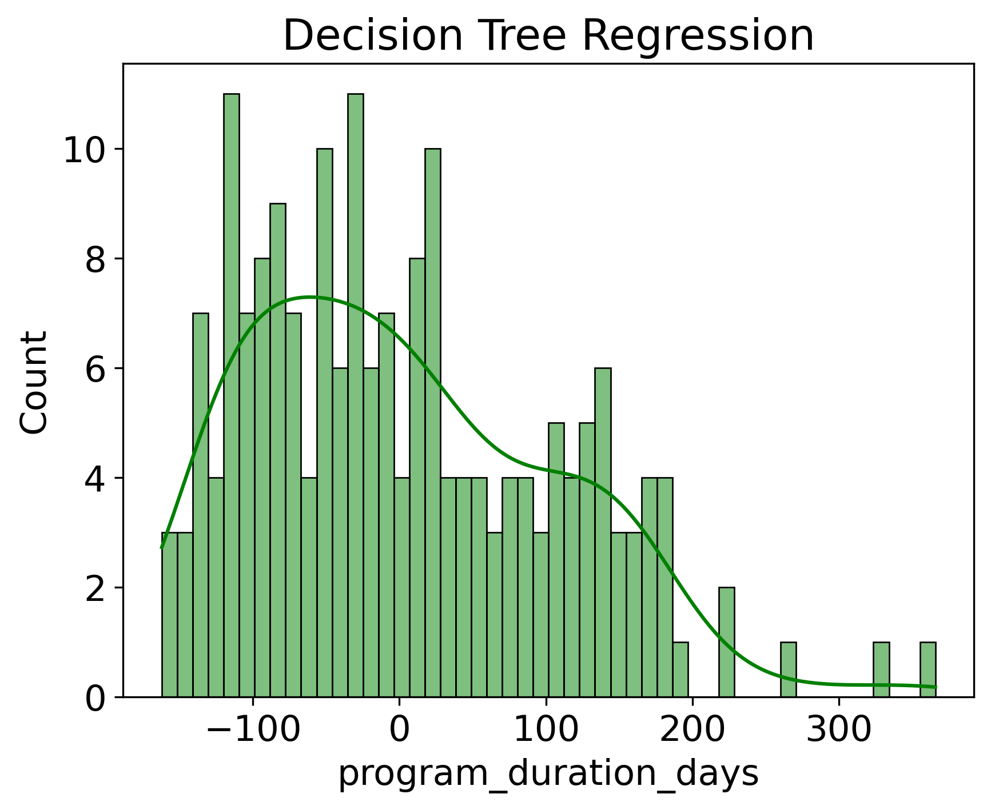
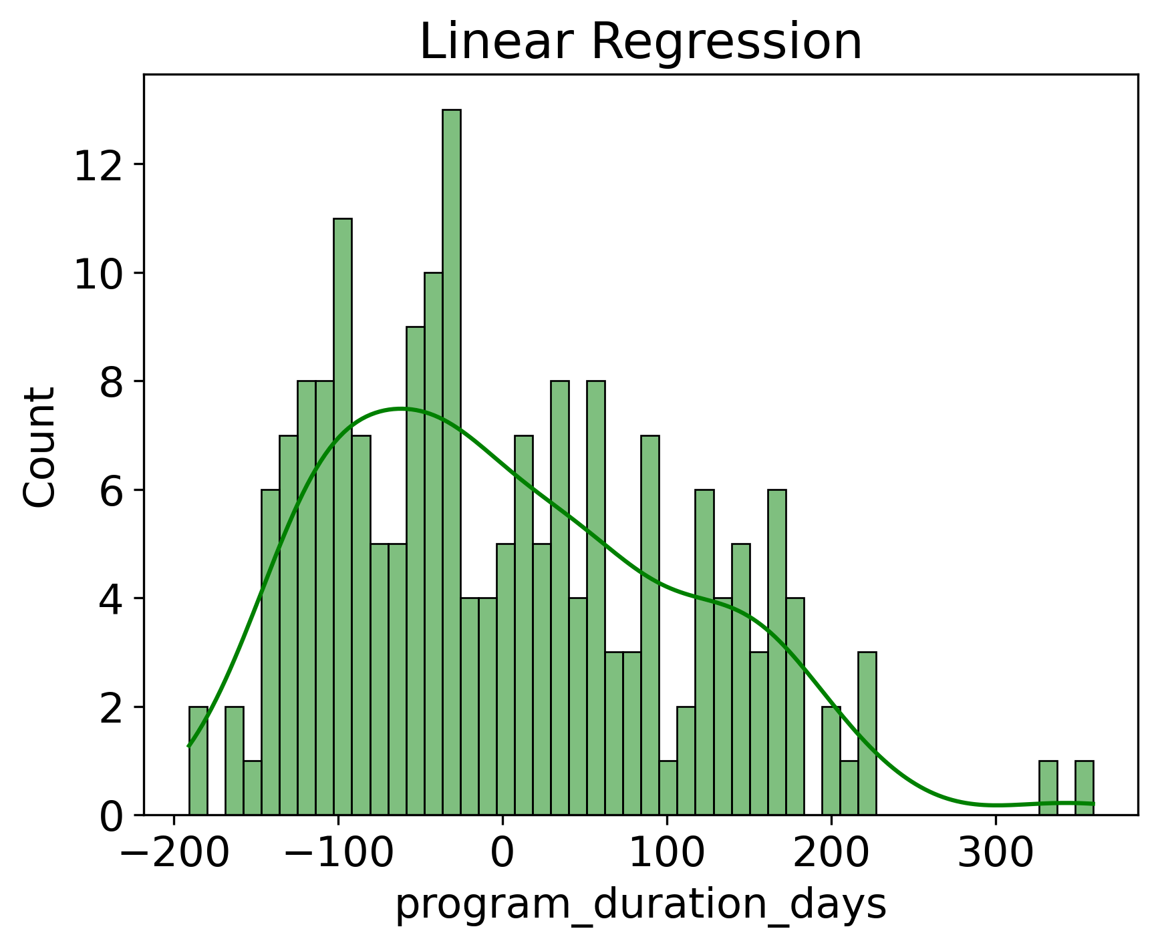
Regression results
Comparison of residual distributions for different models
 | Linear Regression | Decision Tree Regression | Support Vector Regression
MAE | 87.5 | 86.6 | 83.7
MSE | 11219.7 | 11043.6 | 10949
RMSE | 105.9 | 105.1 | 104.6
Support vector regression model shows a bit better performance
A value of 83.7 for the mean absolute error (MAE) means that the model result has a tolerance between +84 and -84.

Slide 34
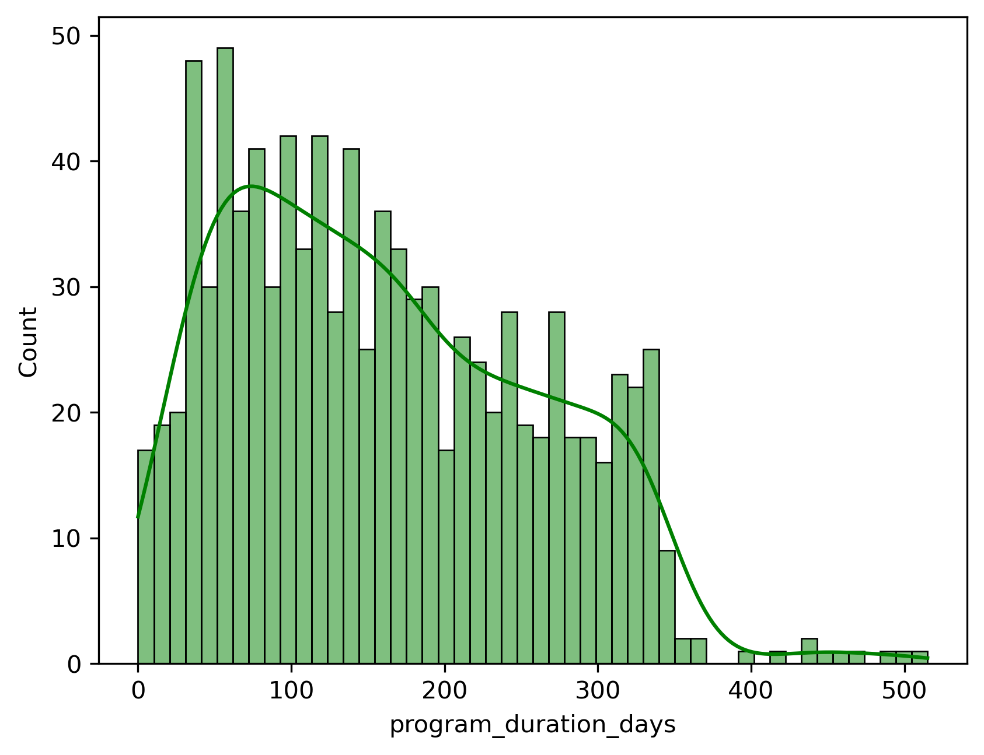
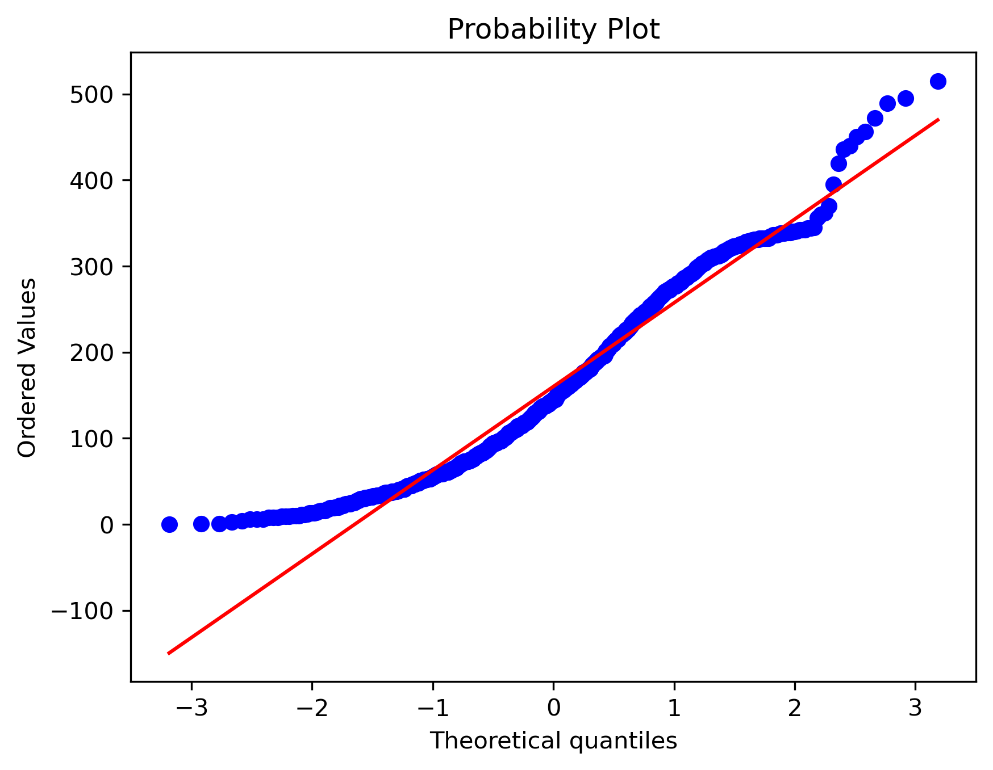
Regression results
Why do the regression models show low performance?
High dispersion of the response variable
 | Program duration days
Mean | 160
Std | 99
Percentile 25% | 76
Percentile 50% | 145
Percentile 75% | 236
Mean

Slide 35
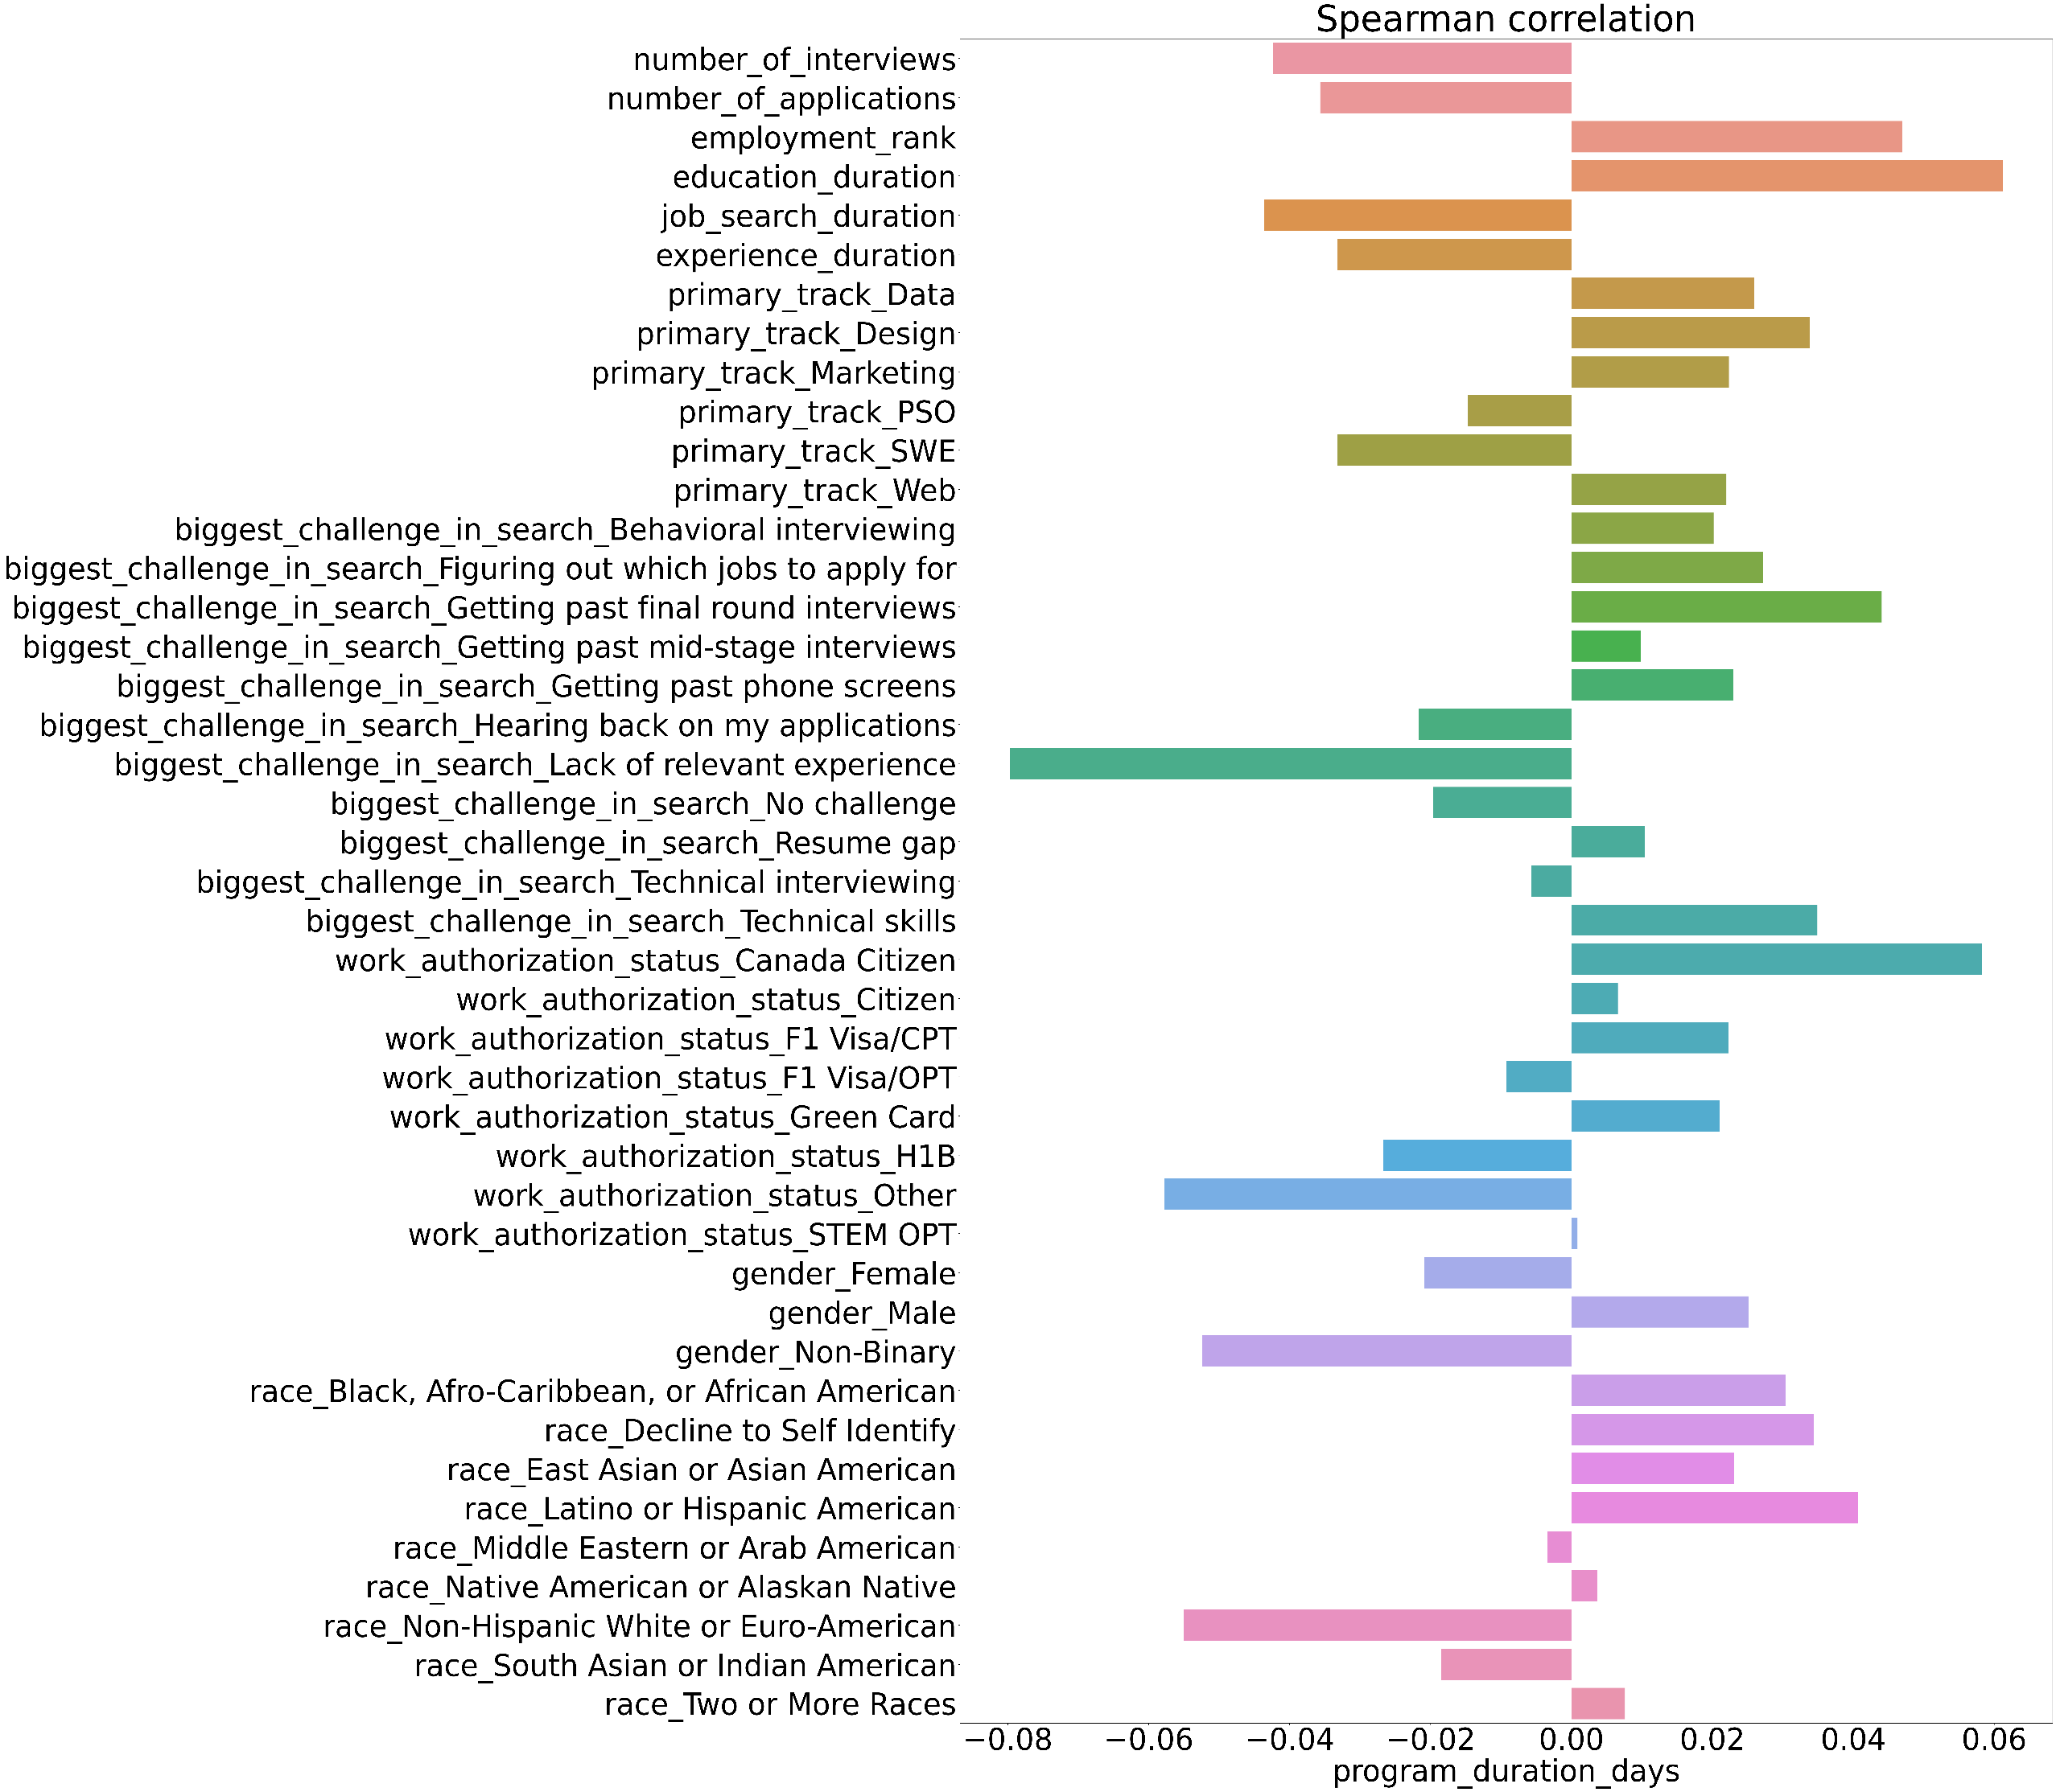
Regression results
Why do the regression models show low performance?
Low dependence of independent variables on the response variable
It is highly recommended to go back to the data collection stage and select more relevant data such as age , spending time on program per week and so on.
Business understanding
Analytic approach
Feedback
Data requirements
Development
Data collection
Evaluation
Data Understanding
Modelling
Data preparation

Slide 36
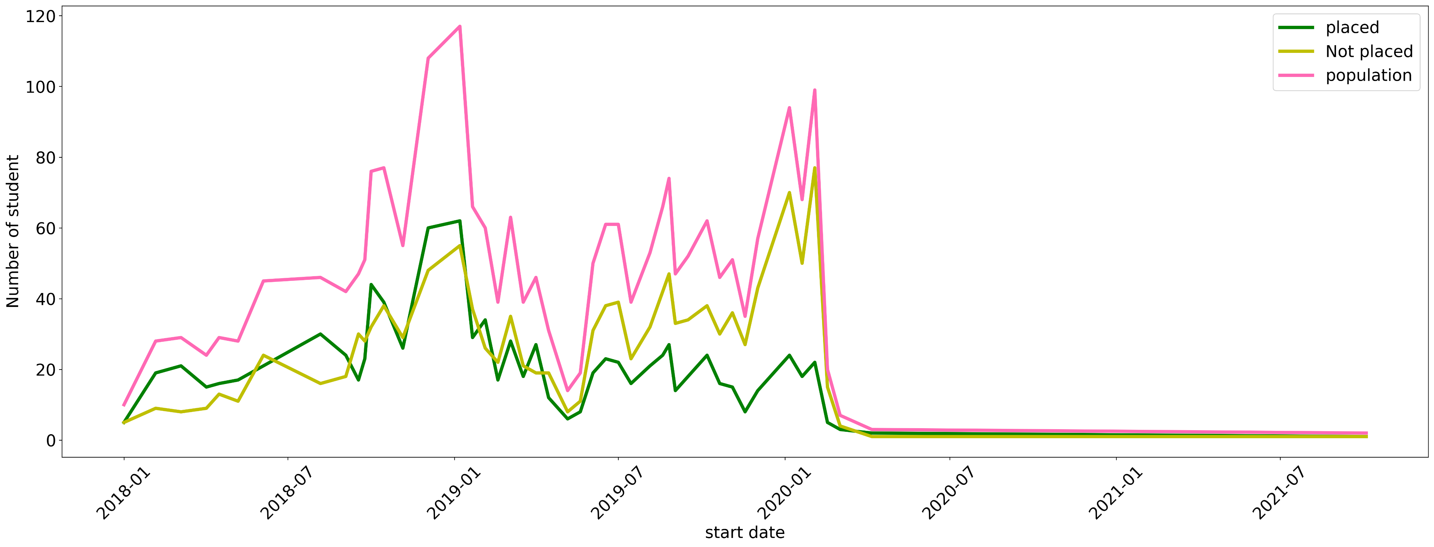
Some proposals for future Research
Examining the number of different groups of people over time
The greatest number of participant
What happened?
Failure analyze
A downward trend with a low slope
A sharp decrease in the number of participants

Slide 37
Thanks For watching
For more information please see my GitHub
https://github.com/Rezassp/Pathrise

